Slide 1
DEFINE PHASE

Slide 2
Scenario
Textile Corporation is Pune, India based garment manufacturing company started in 2000 By Mr. Shreeram Deshmukh. Over last 15-17 years company was well handled by Mr. Shreeram, his intelligent Manager Mr. Ramesh Joshi. However, over last 3-4 years Textile corporation started seeing losses in the business.
They started receiving backorders and client complaints frequently. Mr. Ajay Rane who owns renowned garment company, was Mr. Deshmukh important client. One fine day Mr. Rane called up to Mr. Ramesh and told, “Almost 20 out 150 Sweatshirts they ordered are missing collar buttons, 4-5 Sweatshirts are damaged pieces. Not only this, I was supposed to export few Sweatshirts to US based client yesterday but I couldn't because of these issues. I lost export opportunity and paid heavy penalty to the clients for the same. Mr. Ramesh, this was my last assignment to your company, I will not purchase any further product from your company." This is seventh client Textile corporation lost over last six months.
Mr. Ramesh told about this incidence to Mr. Deshmukh and also said, "We already have quality target of 95% to be achieved. I am not understanding why such problems are frequently occurring". Mr. Ramesh and Mr. Shreeram are in trouble and need some help to regain there market share.

Slide 3

Identification of VOC and I-E Customers
Parameters | Identified Area
Voice of Customer | “Almost 20 out 150 Sweatshirts they ordered are missing collar buttons, 4-5 Sweatshirts are damaged pieces. Not only this, I supposed to export few Sweatshirts to US based client yesterday but I couldn't because of these issues. I lost export opportunity and paid heavy penalty to the clients for the same. Mr. Ramesh, this was my last assignment to your company, I will not purchase any further product from your company."
External Customer | Mr. Ajay Rane
Internal Customer | Mr. Ramesh Joshi & Mr. Deshmukh
Critical to Quality | The quality performance must achieve the target of 95%
Proprietary and Highly Confidential. 2020 Pursullence Global Business Solutions. All Rights Reserved
Notes:
Business Case Premise: Textile Corporation is Pune, India based garment manufacturing company started in 2000 By Mr. Shreeram Deshmukh. Over last 15-17 years company was well handled by Mr. Shreeram, his intelligent Manager Mr. Ramesh Joshi. However, over last 3-4 years Textile corporation started seeing losses in the business.
They started receiving backorders and client complaints frequently. Mr. Ajay Rane who owns renowned garment company, was Mr. Deshmukh important client. One fine day Mr. Rane called up to Mr. Ramesh and told, “Almost 20 out 150 Sweatshirts they ordered are missing collar buttons, 4-5 Sweatshirts are damaged pieces. Not only this, I was supposed to export few Sweatshirts to US based client yesterday but I couldn't because of these issues. I lost export opportunity and paid heavy penalty to the clients for the same. Mr. Ramesh, this was my last assignment to your company, I will not purchase any further product from your company." This is seventh client Textile corporation lost over last six months.
Mr. Ramesh told about this incidence to Mr. Deshmukh and also said, "We already have quality target of 95% to be achieved. I am not understanding why such problems are frequently occurring". Mr. Ramesh and Mr. Shreeram are in trouble and need some help to regain there market share.

Slide 4

DATA COLLECTION PLAN
Click here
Notes:
Open the excel file given in this slide and understand the data.

Slide 5
PROJECT CHARTER

Slide 6
Business Case
Project Scope:
In-scope: This project is conducted for process 1
Out-scope: This project is applicable only for process 1 of Pune location.
Textile Corporation is Pune, India based garment manufacturing company started in 2000 by Mr. Shreeram Deshmukh. Over last 15-17 years company was well handled by Mr. Shreeram, his intelligent Manager Mr. Ramesh Joshi.
However, over last 3-4 years Textile Corporation corporation started seeing losses in the business. They started receiving backorders and client complaints frequently. Mr. Ajay Rane who owns renowned garment company, was Mr. Deshmukh important client for. Textile Corporation corporation lost seven clients over last six months. They are in trouble.
QNS
In money
Client retention rate will increase with increasing quality percentage
Team Members
Role | Name | Org.
Black Belt/ Manager | Mr. Ramesh Joshi | Textile Corporation
MBB/mentor/Sr. Manager | Mr. Joseph Arthur | Textile Corporation
GB | Mr. Ajay Raman | Textile Corporation
Core Team | Ms. Delnaz Patro, Mr. Shrinivas Gupta | Textile Corporation
Process Owner/ Champion | Mr. Harsh Jindal | Textile Corporation
SME | Ms. Heena Parmar | Textile Corporation
Finance | Ms. Neha Sajdeh | Textile Corporation
Problem Statement:
Out of 92 observations of historical data 84 have not met the quality performance that is 91.30% of the observations.
Project Timeline
Phase | Start Date | End Date
Define | 15th February 2020 | 27th February 2020
Measure | 1st March 2020 | 30th March 2020
Analyze | 1st April 2020 | 10th April 2020
Improve | 11th April 2020 | 15th May 2020
Control | 16th May 2020 | 30th June 2020
Goal Statement
The quality performance must achieve the target of95%.
Proprietary and Highly Confidential. 2020 Pursullence Global Business Solutions. All Rights Reserved
Notes:
Use the following statement as business case:
Hints for Problem Statement:
Go through historical data
Find the average score in excel
Client has informed that there has to be min 95% quality met for each day delivered.
Please check percent quality each day and it should not be lower than 95%.
Hints for Goal Statement:
Please prepare your ‘time binding’ statement based on improving average quality percentage per day from current average to client specified limit..
Refer our previous project

Slide 7
SIPOC:
Fill in the gap with appropriate answer and compete the SIPOC
SUPPLIER
INPUT
PROCESS
OUTPUT
CUSTOMER
Phone or email contact arrives at agents desk
Complain raised by customer
Agent resolves the issue
If the issue is not solved pass it to the supervisor /manager
The issue is resolved and notify the customer
Agent ask to customer satisfaction rating/score
Issue is resolved
Customer seeking service
Laptop/Phone
Process individuals
Proprietary and Highly Confidential. 2020 Pursullence Global Business Solutions. All Rights Reserved
Notes:
Please refer process map given in next step and draw a high level process step. Also refer our training manual and other project as a reference. Insert the text box for each column to insert the answer.
Hint for fill in the blanks:
Understand the full form of SIPOC and fill in the correct word in blue box replacing the dash.

Slide 8

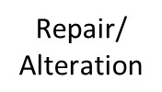
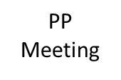
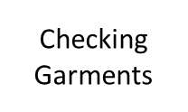

Process Map:
Quality - Help Desk Process Map
Click here
Notes:
Please refer the attached excel files for reference and clear view of process map
Observe the process map given and try to understand the flow of work.

Slide 9
COMMUNICATION PLAN (RACI MATRIX)
Sr. No | RACI | RESPONSIBLE PERSON | NAME OF PERSON
1 | Responsible | Green Belt | Mr. Ajay Raman
2 | Approval | Manager | Mr. Ramesh Joshi
3 | Consult | Sr. Manager | Mr. Joseph Arthur
4 | Inform | Process Owner/MBB | Mr. Harsh Jindal / Mr. Joseph Arthur
Review | RESPONSIBLE PERSON | NAME OF PERSON
Weekly | Responsible, Approval | Mr. Ajay Raman and Mr. Ramesh Joshi
Fortnightly | Responsible, Approval & Consult | Mr. Ajay Raman and Mr. Ramesh Joshi and Mr. Joseph Arthur
Monthly/Tollgate | Responsible, Approval, Consult & Inform | Mr. Ajay Raman and Mr. Ramesh Joshi and Mr. Joseph Arthur and Mr. Harsh Jindal
Notes:
Please refer the previous project for communication plan construction and team member from project charter of this project to construct the matrix.
Hint for fill in the blanks for first table:
Choose the correct answer from the options given below and fill in blanks in column RACI.
Sr.No 1
Report
Responsible
Receive
Regenerate
Sr.No 2
Accessible
Answerable
Accountable
Approve
Sr.No 3
Communicate
Convey
Confirm
Consult
Sr.No 4
Inform
Indicate
Improve
Innovate

Slide 10
MEASURE PHASE

Slide 11
Operational Definition
% QUALITY SCORE PER DAY
= 1- ( No. of defectives shirts / Total no. of shirts)
Performance Standards
Unit Of Measure (UOM)
Every single working day shirts manufactured.
% Quality score of shirts manufactured per day
Opportunity
Data (Y) - Continuous
Every single working day shirts manufactured
Data Source
Excel Database / Software Tool
Specification Limits & Target Value
USL – NA Target- 93 %
LSL – 91 %
Defective Definition:
Every single day when % Quality score of shirts
manufactured is below 91 %.
Proprietary and Highly Confidential. 2020 Pursullence Global Business Solutions. All Rights Reserved
Notes:
NOTE:- Performance Standards are already prepared and provided for your reference.

Slide 12
MEASUREMENT SYSTEM ANALYSIS
As Data Is Collected From System I.E. Data Is Generated From Helpdesk Ticketing Tool, So There Is No Need To Perform MSA
Proprietary and Highly Confidential. 2020 Pursullence Global Business Solutions. All Rights Reserved
Notes:
NOTE:- In this case there is no need to perform MSA as data is system driven.

Slide 13
List of Potential Causes
SR NO | CAUSES
1 | TOTAL NO. OF SHIRTS STICHED
2 | NO. OF DEFECTIVE SHIRTS
3 | FAULTY ZIPPERS
4 | IRREGULAR HEMMING
5 | WRONG GRADATION OF SIZES
6 | MISS OUT OF STITCHES IN BETWEEN
7 | WRONG STITCHING TECHNIQUES USED
SR NO | CAUSES
8 | WRONG SIZE PACKAGING
9 | WRONG COLOUR COMBINATION
10 | IMPROPER LABEL DIMENSIONS
11 | IMPROPER BUTTON HOLES
12 | LACK OF TRAINING
13 | SHORTAGE OF TECHNICAL SKILLS
14 | SEWING NEEDLE BREAKS
15 | WRONG QUALITY CHECK
Proprietary and Highly Confidential. 2020 Pursullence Global Business Solutions. All Rights Reserved
Notes:
NOTE :- Given List of Potential Causes are obtained from Brainstorming sessions conducted during measure phase along with SME’s, Process Manager provided for your reference.

Slide 14
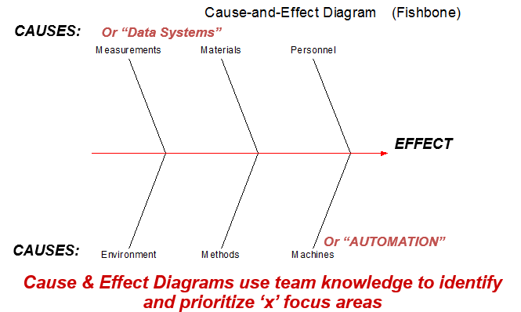
Ishikawa / Fishbone/ Cause & Effect Diagram
WRONG GRADATION OF SIZES
WRONG SIZE PACKAGING
IRREGULAR HEMING
FAULTY ZIPPERS
NO OF DEFECTIVESHIRTS
TOTAL NO OF SHIRTS
STICHED
WRONG SIZE PACKAGING
WRONG COLOUR
COMBINATION
LACK OF TRAINING
SHORTAGE OF TECHNICAL SKILLS
IMPROPER LABEL DIMENSIONS
% Quality score of shirts manufactured
per day
day
)
MISS OUT OF STICHES IN BETWEEN
SEWING NEEDLE BREAKS
IMPROPER BUTTON HOLES
WRONG STICHING TECHNIQUE USED
WRONG QUALITY CHECK
Proprietary and Highly Confidential. 2020 Pursullence Global Business Solutions. All Rights Reserved
Notes:
HINT:-
Refer to slide list of potential causes.
From the available list of potential causes, segregate those causes into the categories of Fishbone diagram.
Categorize those causes into current slide of Fishbone diagram.
Note :- For e.g.- IMPROPER LABEL DIMENSIONS is into personal category . Similarly do the remaining causes segregation.

Slide 15
C-I MATRIX
SR NO | CAUSES | TYPE
 |  | CONTROLLABLE/ NON CONTROLLABLE | IMPACTABLE/NON-IMPACTABLE | MEASUREABLE/NON-MEASUREABLE
1 | FAULTY ZIPPERS | CONTROLLABLE | IMPACTABLE | MEASUREABLE
2 | LOOSE BUTTONS | CONTROLLABLE | IMPACTABLE | MEASUREABLE
3 | IRREGULAR HEMMING | CONTROLLABLE | IMPACTABLE | MEASUREABLE
4 | IMPROPER BUTTON HOLES | CONTROLLABLE | IMPACTABLE | MEASUREABLE
5 | WRONG GRADATION OF SIZES | CONTROLLABLE | IMPACTABLE | MEASUREABLE
6 | MISS OUT OF STITCHES IN BETWEEN | CONTROLLABLE | IMPACTABLE | MEASUREABLE
7 | WRONG STITCHING TECHNIQUES USED | CONTROLLABLE | IMPACTABLE | MEASUREABLE
8 | WRONG SIZE PACKAGING | CONTROLLABLE | IMPACTABLE | MEASUREABLE
9 | WRONG COLOUR COMBINATION | CONTROLLABLE | IMPACTABLE | MEASUREABLE
10 | IMPROPER LABEL DIMENSIONS | CONTROLLABLE | IMPACTABLE | MEASUREABLE
Proprietary and Highly Confidential. 2020 Pursullence Global Business Solutions. All Rights Reserved
Notes:
NOTE:- C- I matrix is already prepared and provided for your reference.

Slide 16
C-I MATRIX
SR NO | CAUSES | TYPE
 |  | CONTROLLABLE/ NON CONTROLLABLE | IMPACTABLE/NON-IMPACTABLE | MEASUREABLE/NON-MEASUREABLE
11 | IMPROPER BUTTON HOLES | NON-CONTROLLABLE | NON-IMPACTABLE | NON-MEASUREABLE
12 | SHORTAGE OF TECHNICAL SKILLS | CONTROLLABLE | IMPACTABLE | NON-MEASUREABLE
13 | SEWING NEEDLE BREAKS | NON-CONTROLLABLE | IMPACTABLE | MEASUREABLE
14 | WRONG QUALITY CHECK | NON-CONTROLLABLE | NON-IMPACTABLE | NON-MEASUREABLE
15 | LACK OF TRAINING | NON-CONTROLLABLE | NON-IMPACTABLE | NON-MEASUREABLE
Proprietary and Highly Confidential. 2020 Pursullence Global Business Solutions. All Rights Reserved
Notes:
NOTE:- C- I matrix is already prepared and provided for your reference.

Slide 17
Data Collection Plan
CONTROLLABLE / NON CONTROLLABLE |  |  | OPERATIONAL DEFINATION | SAMPLING PLAN
What To Measure | Y Or X | Data Type | Operational Definition | What | Where | When | How Many
% Quality of shirts manufactured per day (Y) | Y | Continuous | % QUALITY PER DAY = 1- ( No. of defectives shirts / Total no. of shirts) | No of shirts manufactured per day | Database /Excel database | 02/03/2020 to 27/03/2020 | Min 30
FAULTY ZIPPERS | X1 | Discrete | No of incidences | No of shirts manufactured per day | Database /Excel database | 02/03/2020 to 27/03/2020 | Min 30
LOOSE BUTTONS | X2 | Discrete | No of incidences | No of shirts manufactured per day | Database /Excel database | 02/03/2020 to 27/03/2020 | Min 30
IRREGULAR HEMMING | X3 | Discrete | No of incidences | No of shirts manufactured per day | Database /Excel database | 02/03/2020 to 27/03/2020 | Min 30
IMPROPER BUTTON HOLES | X4 | Discrete | No of incidences | No of shirts manufactured per day | Database /Excel database | 02/03/2020 to 27/03/2020 | Min 30
WRONG GRADATION OF SIZES | X5 | Discrete | No of incidences | No of shirts manufactured per day | Database /Excel database | 02/03/2020 to 27/03/2020 | Min 30
MISS OUT OFSTITCHES IN BETWEEN | X6 | Discrete | No of incidences | No of shirts manufactured per day | Database /Excel database | 02/03/2020 to 27/03/2020 | Min 30
Proprietary and Highly Confidential. 2020 Pursullence Global Business Solutions. All Rights Reserved
Notes:
NOTE:- Data Collection Plan is already prepared and provided for your reference for both Y & X’s.

Slide 18
Data Collection Plan
CONTROLLABLE / NON CONTROLLABLE |  |  | OPERATIONAL DEFINATION | SAMPLING PLAN
What To Measure | Y Or X | Data Type | Operational Definition | What | Where | When | How Many
WRONG STITCHING TECHNIQUES USED | X7 | Discrete | No of incidences | No of shirts manufactured per day | Database /Excel database | 02/03/2020 to 27/03/2020 | Minimum 20 samples
WRONG SIZE PACKAGING | X8 | Discrete | No of incidences | No of shirts manufactured per day | Database /Excel database | 02/03/2020 to 27/03/2020 | Minimum 20 samples
WRONG COLOUR COMBINATION | X9 | Discrete | No of incidences | No of shirts manufactured per day | Database /Excel database | 02/03/2020 to 27/03/2020 | Minimum 20 samples
IMPROPER LABEL DIMENSIONS | X10 | Discrete | No of incidences | No of shirts manufactured per day | Database /Excel database | 02/03/2020 to 27/03/2020 | Minimum 20 samples
Proprietary and Highly Confidential. 2020 Pursullence Global Business Solutions. All Rights Reserved
Notes:
NOTE:- Data Collection Plan is already prepared and provided for your reference for both Y & X’s.

Slide 19
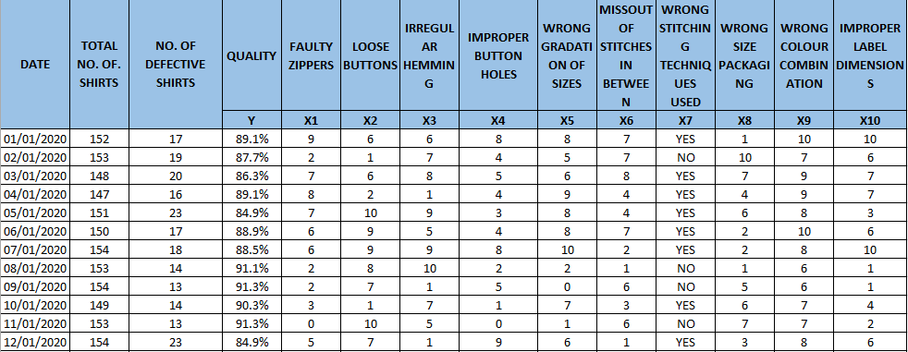
Data Collection in Excel format
Click here
Proprietary and Highly Confidential. 2020 Pursullence Global Business Solutions. All Rights Reserved
Notes:
Note:- Excel sheet dataset is embedded into slide for your reference

Slide 20
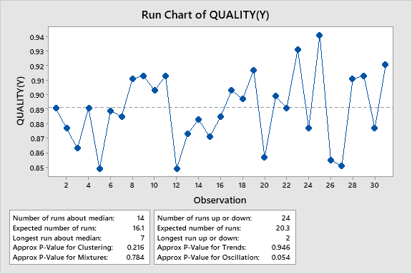
Stability Analysis- Run Chart
Interpretation: If p-value for all clustering ,mixtures ,trends & oscillations are greater than 0.05 ,therefore the data is stable.
Proprietary and Highly Confidential. 2020 Pursullence Global Business Solutions. All Rights Reserved
Notes:
Hint:
Step 1: Select the data and perform the Stability test using Run chart in Minitab tool by referring the steps below.
Step 2: Follow this Minitab Path to get the output : Stat->Quality Tools –> Run Chart
Step 3: Paste the output of Run chart in the given box and write interpretation by reading the chart

Slide 21
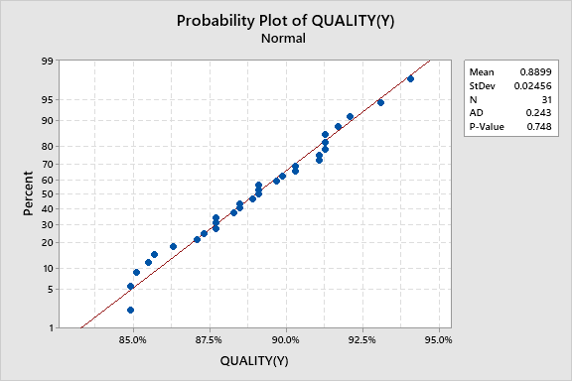
Normality Analysis- Normality Chart
Interpretation: This graph shows that there are outliers in the ‘tails’ of this data set that don’t fall on blue line; this points should be investigated further. Are this data truly part of the real process , or were they caused by unusual , non recurring events.
Proprietary and Highly Confidential. 2020 Pursullence Global Business Solutions. All Rights Reserved
Notes:
Hint:
Step 1: Select the data and perform the Normality test in Minitab tool by referring the steps below.
Step 2: Follow this Minitab Path to get the output : Stat->Basic Statistics –> Normality Test
Step 3: Paste the output of Normality Test in the given box and write interpretation by reading the p value.

Slide 22
CAPABILITY ANALYSIS
DEFECTIVE DEFINITION | Every single data when % Quality score of shirts manufactured is below 91%
TOTAL UNITS | 31
TOTAL OPPORTUNITIES | 31
DEFECTIVE | 22
DEFECTS/DEFECTIVES PER OPPORTUNITIES ( HINT: Using DPO formula calculate DPO value) | 0.709677
DEFECTIVES PER MILLION OPPORTUNITIES ( HINT: Using DPMO formula calculate value ) | 709677.4193
LONG TERM SIGMA VALUE (ZLT) ( HINT: Use formula :- normsinv( 1- DPO) | -0.55244
SHORT TERM SIGMA VALUE (ZST) ( HINT: N/A) | NA
Proprietary and Highly Confidential. 2020 Pursullence Global Business Solutions. All Rights Reserved
Notes:
HINT:-
Refer to the DPMO formulas & find the appropriate values of parameters of capability analysis.
2) CAPABILITY ANALYSIS: Solutions for Capability analysis are displayed in hint section.
1) Defective Definition -
2) Total Units -
3) Total Opportunities -
4) Defective -
5) Defects/Defectives Per Opportunities -
6) Defectives Per Million Opportunities -
7) LONG TERM SIGMA VALUE (ZLT) = normsinv ( 1- DPO) =

Slide 23
ANALYZE PHASE

Slide 24
GRAPHICAL ANALYSIS
Proprietary and Highly Confidential. 2020 Pursullence Global Business Solutions. All Rights Reserved

Slide 25
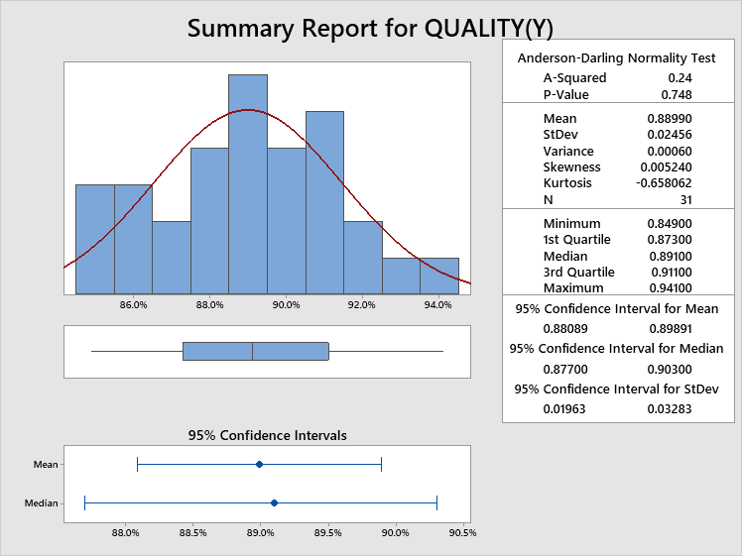
Histogram via ‘Graphical Summary’ – For % Quality Score Per Day
Minitab Session Window output:
Interpretation: As p-value is greater than 0.05 it indicates normality of plot.
Proprietary and Highly Confidential. 2020 Pursullence Global Business Solutions. All Rights Reserved
Notes:
Steps to draw Histogram:
Step1: Minitab Path: Stat> Basic Statistics> Graphical Summary (enter ‘Quality’ for ‘Variables’)
Step2: Draw the conclusion from the histogram about Normality of the data.
Step3: Observe the basic statistics, look at the graph, observe and write interpretation about the shape of the histogram and spread of the data.

Slide 26
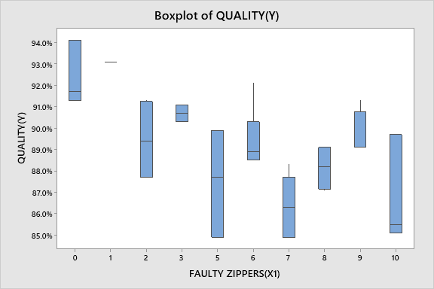
BOX-PLOT
Output:- BOX PLOT FOR QUALITY (Y) VS. FAULTY ZIPPERS (X1)
Interpretation: Since we can see that faulty zippers has significant impact on quality. Since we can observe that data points 5,7,10 are below Service Level Agreement limit.
Proprietary and Highly Confidential. 2020 Pursullence Global Business Solutions. All Rights Reserved
Notes:
Steps to draw a box plot:
Step 1: For continuous Y and Discrete X we can draw box-plot.
Step 2: Follow this Minitab Path to get the output : Graph–> Box Plot
Step 3: Paste the Box Plot in the given blank box and write interpretation by reading the plot

Slide 27
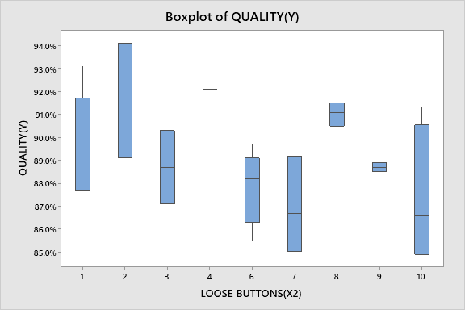
BOX-PLOT
Output:- BOX PLOT FOR QUALITY (Y) VS. LOOSE BUTTONS (X2)
Interpretation: we can see that loose buttons has significant impact on quality. Since we can observe that data points 10 ,6,7 are below Service Level Agreement limit
Proprietary and Highly Confidential. 2020 Pursullence Global Business Solutions. All Rights Reserved
Notes:
Steps to draw a box plot:
Step 1: For continuous Y and Discrete X we can draw box-plot.
Step 2: Follow this Minitab Path to get the output : Graph–> Box Plot
Step 3: Paste the Box Plot in the given blank box and write interpretation by reading the plot

Slide 28
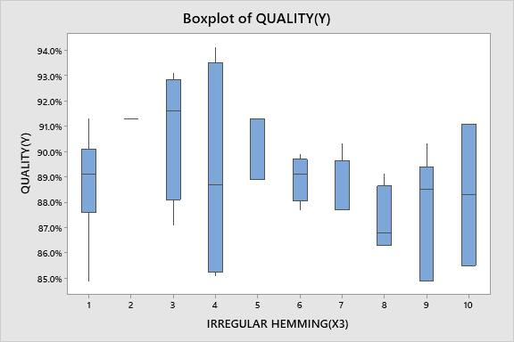
BOX-PLOT
Output:- BOX PLOT FOR QUALITY (Y) VS. IRREGULAR HEMMING (X3)
Interpretation: Since we can see that irregular hemming has significant impact on quality. Since we can observe that data points 4,8,9,10 are below Service Level .
Proprietary and Highly Confidential. 2020 Pursullence Global Business Solutions. All Rights Reserved
Notes:
Steps to draw a box plot:
Step 1: For continuous Y and Discrete X we can draw box-plot.
Step 2: Follow this Minitab Path to get the output : Graph–> Box Plot
Step 3: Paste the Box Plot in the given blank box and write interpretation by reading the plot

Slide 29
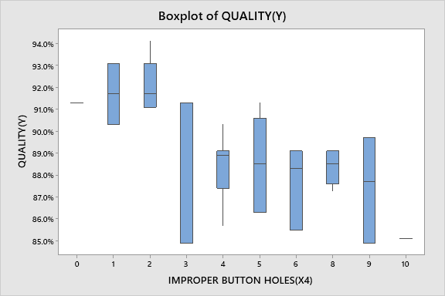
BOX-PLOT
Output:- BOX PLOT FOR QUALITY (Y) VS. IMPROPER BUTTON HOLES (X4)
Interpretation: Since we can see that improper button holes has significant impact on quality. Since we can observe that data points 3,6,9 are below Service Level Agreement limit.
Proprietary and Highly Confidential. 2020 Pursullence Global Business Solutions. All Rights Reserved
Notes:
Steps to draw a box plot:
Step 1: For continuous Y and Discrete X we can draw box-plot.
Step 2: Follow this Minitab Path to get the output : Graph–> Box Plot
Step 3: Paste the Box Plot in the given blank box and write interpretation by reading the plot

Slide 30
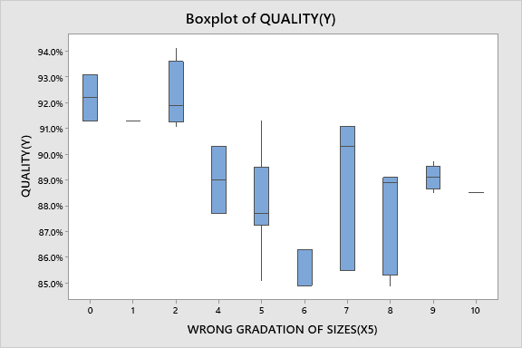
BOX-PLOT
Output:- BOX PLOT FOR QUALITY (Y) VS. WRONG GRADATION OF SIZES (X5)
Interpretation: Since we can see that improper button holes has significant impact on quality. Since we can observe that data points 3,6,9 are below Service Level Agreement limit.
Proprietary and Highly Confidential. 2020 Pursullence Global Business Solutions. All Rights Reserved
Notes:
Steps to draw a box plot:
Step 1: For continuous Y and Discrete X we can draw box-plot.
Step 2: Follow this Minitab Path to get the output : Graph–> Box Plot
Step 3: Paste the Box Plot in the given blank box and write interpretation by reading the plot

Slide 31
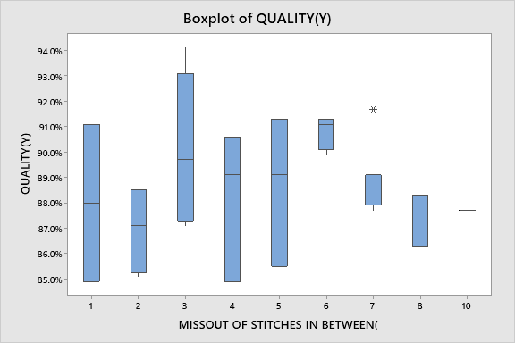
BOX-PLOT
Output:- BOX PLOT FOR QUALITY (Y) VS. MISS OUT OF STITCHES IN BETWEEN (X6)
Interpretation: Since we can see that miss out of stitches in between has significant impact on quality. Since we can observe that data points 1,2,4,5 are below Service Level Agreement limit.
Proprietary and Highly Confidential. 2020 Pursullence Global Business Solutions. All Rights Reserved
Notes:
Steps to draw a box plot:
Step 1: For continuous Y and Discrete X we can draw box-plot.
Step 2: Follow this Minitab Path to get the output : Graph–> Box Plot
Step 3: Paste the Box Plot in the given blank box and write interpretation by reading the plot

Slide 32
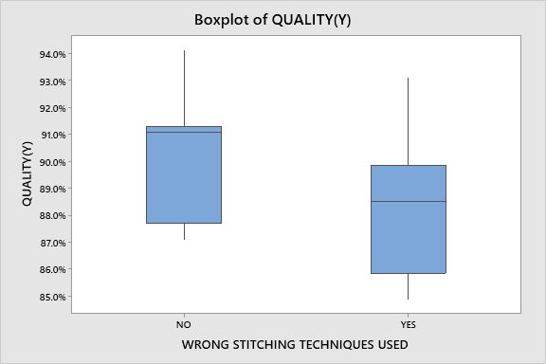
BOX-PLOT
Output:- BOX PLOT FOR QUALITY (Y) VS. WRONG STITCHING TECHNIQUES USED (X7)
Interpretation: Since we can see that wrong stitching techniques used has significant impact on quality. Since we can observe that data points “yes” are below Service Level Agreement limit.
Proprietary and Highly Confidential. 2020 Pursullence Global Business Solutions. All Rights Reserved
Notes:
Steps to draw a box plot:
Step 1: For continuous Y and Discrete X we can draw box-plot.
Step 2: Follow this Minitab Path to get the output : Graph–> Box Plot
Step 3: Paste the Box Plot in the given blank box and write interpretation by reading the plot

Slide 33
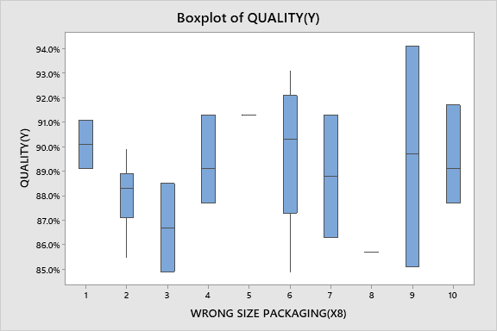
BOX-PLOT
Output:- BOX PLOT FOR QUALITY (Y) VS. WRONG SIZE PACKAGING (X8)
Interpretation: Since we can see that wrong size packaging has significant impact on quality. Since we can observe that data points 3,6,9 are below Service Level Agreement limit.
Proprietary and Highly Confidential. 2020 Pursullence Global Business Solutions. All Rights Reserved
Notes:
Steps to draw a box plot:
Step 1: For continuous Y and Discrete X we can draw box-plot.
Step 2: Follow this Minitab Path to get the output : Graph–> Box Plot
Step 3: Paste the Box Plot in the given blank box and write interpretation by reading the plot

Slide 34
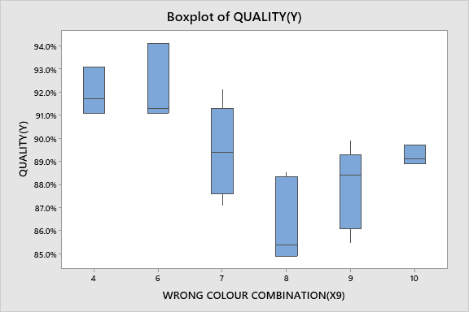
BOX-PLOT
Output:- BOX PLOT FOR QUALITY (Y) VS. WRONG COLOUR COMBINATION (X9)
Interpretation: Since we can see that wrong color combination has significant impact on quality. Since we can observe that data points 7,8,9 are below Service Level Agreement limit.
Proprietary and Highly Confidential. 2020 Pursullence Global Business Solutions. All Rights Reserved
Notes:
Steps to draw a box plot:
Step 1: For continuous Y and Discrete X we can draw box-plot.
Step 2: Follow this Minitab Path to get the output : Graph–> Box Plot
Step 3: Paste the Box Plot in the given blank box and write interpretation by reading the plot

Slide 35
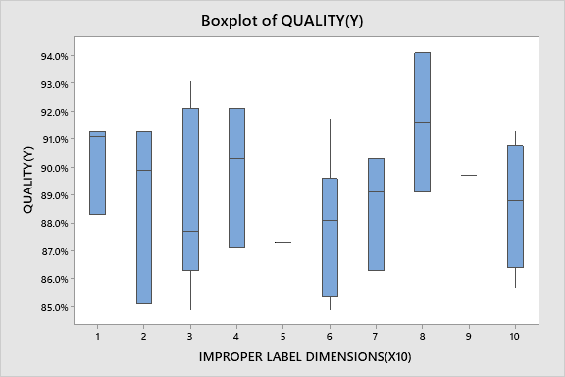
BOX-PLOT
Output:- BOX PLOT FOR QUALITY (Y) VS. IMPROPER LABEL DIMENSIONS (X10)
Interpretation: Since we can see that improper label dimensions has significant impact on quality. Since we can observe that data points 2,3,6,10 are below Service Level Agreement limit.
Proprietary and Highly Confidential. 2020 Pursullence Global Business Solutions. All Rights Reserved
Notes:
Steps to draw a box plot:
Step 1: For continuous Y and Discrete X we can draw box-plot.
Step 2: Follow this Minitab Path to get the output : Graph–> Box Plot
Step 3: Paste the Box Plot in the given blank box and write interpretation by reading the plot

Slide 36
INFERENTIAL TEST
Proprietary and Highly Confidential. 2020 Pursullence Global Business Solutions. All Rights Reserved

Slide 37
Important Note 1:
Before going to start with inferential analysis we need to check the rules:
Rule 1: Stability of Y (Which is the part of measure phase)
Rule 2: As % Quality Score Per Day i.e. Y is continuous, you need to check normality of the Y (Which is the part of measure phase)
Rule 3: As Y is Continuous and X’s are discrete, you need to perform test for equality of variances.
Proprietary and Highly Confidential. 2020 Pursullence Global Business Solutions. All Rights Reserved
Notes:
Read the slide- Important Note 1: Need to check assumptions/rules first.

Slide 38
Important Note 2:
There are tests which help us to check whether the variances of the groups are same or not and we need to choose those tests by looking at the normality of Y & levels of X’s.
F Test or Two Variance Test – When there are two groups and it is Normally Distributed
Bartlett’s Test – When there are more than two groups and it is Normally Distributed
Levene’s Test - When there are two or more than two groups and it is Not Normally Distributed
Proprietary and Highly Confidential. 2020 Pursullence Global Business Solutions. All Rights Reserved
Notes:
Read the slide- Important Note 2: Selection of test to test the equality of variance.

Slide 39
Test of Equal Variance
HYOTHETICAL PREMISE
The project team believes that there are potential “X’s” that have impact on “Y” (% Quality Score per day).
One need to validate whether impact of potential X’s - “Faulty zippers”, “Loose buttons”, “Irregular hemming”, “Improper button holes”, “Wrong gradation of sizes”, “Miss out of stitches in between”, “Wrong stitching techniques used”, “Wrong size packaging“, “Wrong colour combination”, “Improper label dimensions” is statistically significant or not.
Proprietary and Highly Confidential. 2020 Pursullence Global Business Solutions. All Rights Reserved

Slide 40
Test of Equal Variance (Bartlett’s Test) For Faulty Zippers (X1)
Purpose:
Purpose of performing test of equal variance is: To check if Faulty zippers have impact on quality
HYPOTHESIS:
H_{o}: Variances are same i.e. “Faulty Zippers” has no impact on “Quality”
H_{a}: Variances are different i.e. “Faulty Zippers” has significant impact on “Quality”
Proprietary and Highly Confidential. 2020 Pursullence Global Business Solutions. All Rights Reserved
Notes:
Steps to perform Test of Equality of Variance:
Step 1: Write the purpose of doing Test of Equality of Variance
Step 2: Write Null and Alternate Hypothesis

Slide 41
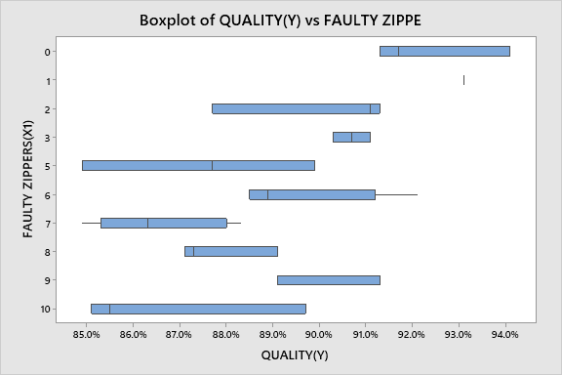
Graphical Output of Test of Equal Variance for Faulty Zippers (X1)
Minitab Session Window output:
Interpretation: From the graph we can observe that, Faulty Zippers has significant impact on Quality. We need to investigate it.
Proprietary and Highly Confidential. 2020 Pursullence Global Business Solutions. All Rights Reserved
Notes:
Steps to perform Test of Equality of Variance continued:
Step 3: Follow this Minitab Path to get the output : Stat>ANOVA>Test for Equal Variances. Run the test and paste the graphical output in the blank space.
Step 4: Write interpretation from the graph.

Slide 42
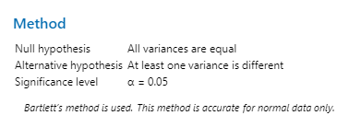
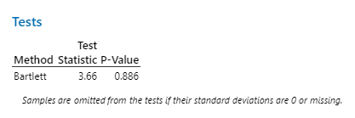
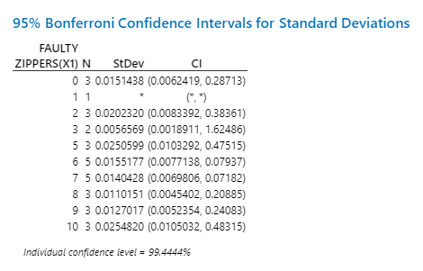
Test Output of Test of Equal Variance for Faulty Zippers (X1)
Minitab Session Window output:
Interpretation: Since p-value is > 0.05, we fail to reject null hypothesis. Hence, we can conclude that, Variances are same i.e. “Faulty zippers” has no impact on “quality”
Proprietary and Highly Confidential. 2020 Pursullence Global Business Solutions. All Rights Reserved
Notes:
Steps to perform Test of Equality of Variance continued:
Step 5: Paste the test output in the blank space.
Step 6: Write interpretation and conclusion from the P-value.

Slide 43
Test of Equal Variance (Bartlett’s Test) For Loose Buttons (X2)
Purpose:
Purpose of performing test of equal variance is: To check if Loose Buttons have impact on quality
HYPOTHESIS:
H_{o}: Variances are same i.e. “Loose Buttons” has no impact on “Quality
H_{a}: Variances are different i.e. “Loose Buttons” has significant impact on “Quality”
Proprietary and Highly Confidential. 2020 Pursullence Global Business Solutions. All Rights Reserved
Notes:
Steps to perform Test of Equality of Variance:
Step 1: Write the purpose of doing Test of Equality of Variance
Step 2: Write Null and Alternate Hypothesis

Slide 44
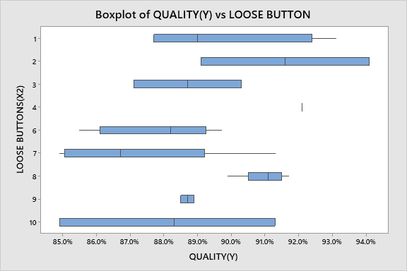
Graphical Output of Test of Equal Variance for Loose Buttons (X2)
Minitab Session Window output:
Interpretation: From the graph we can observe that, Loose Buttons has significant impact on Quality. We need to investigate it.
Proprietary and Highly Confidential. 2020 Pursullence Global Business Solutions. All Rights Reserved
Notes:
Steps to perform Test of Equality of Variance continued:
Step 3: Follow this Minitab Path to get the output : Stat>ANOVA>Test for Equal Variances. Run the test and paste the graphical output in the blank space.
Step 4: Write interpretation from the graph.

Slide 45

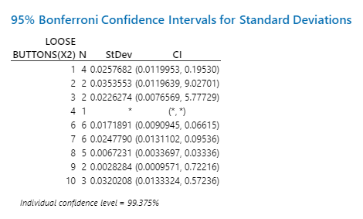
Test Output of Test of Equal Variance for Loose Buttons (X2)
Minitab Session Window output:
Interpretation: Since p-value is > 0.05, we fail to reject null hypothesis. Hence, we can conclude that, Variances are same i.e. “irregular hemming ” has no impact on “quality”
Proprietary and Highly Confidential. 2020 Pursullence Global Business Solutions. All Rights Reserved
Notes:
Steps to perform Test of Equality of Variance continued:
Step 5: Paste the test output in the blank space.
Step 6: Write interpretation and conclusion from the P-value.

Slide 46
Test of Equal Variance (Bartlett’s Test) For Irregular Hemming (X3)
Purpose:
Purpose of performing test of equal variance is: To check if Irregular Hemming have impact on quality
HYPOTHESIS:
H_{o}: Variances are same i.e. “Irregular Hemming” has no impact on “Quality
H_{a}: Variances are different i.e. “Irregular Hemming” has significant impact on “Quality”
Proprietary and Highly Confidential. 2020 Pursullence Global Business Solutions. All Rights Reserved
Notes:
Steps to perform Test of Equality of Variance:
Step 1: Write the purpose of doing Test of Equality of Variance
Step 2: Write Null and Alternate Hypothesis

Slide 47
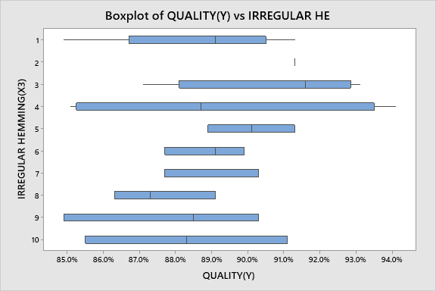
Graphical Output of Test of Equal Variance for Irregular Hemming (X3)
Minitab Session Window output:
Interpretation: From the graph we can observe that, Loose Buttons has significant impact on Quality. We need to investigate it.
Proprietary and Highly Confidential. 2020 Pursullence Global Business Solutions. All Rights Reserved
Notes:
Steps to perform Test of Equality of Variance continued:
Step 3: Follow this Minitab Path to get the output : Stat>ANOVA>Test for Equal Variances. Run the test and paste the graphical output in the blank space.
Step 4: Write interpretation from the graph.

Slide 48

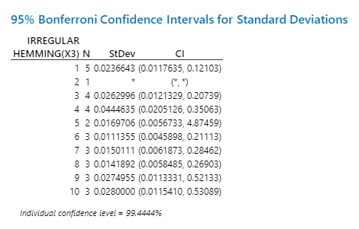
Test Output of Test of Equal Variance for Irregular Hemming (X3)
Minitab Session Window output:
Interpretation: Since p-value is > 0.05, we fail to reject null hypothesis. Hence, we can conclude that, Variances are same i.e. “irregular hemming ” has no impact on “quality”
Proprietary and Highly Confidential. 2020 Pursullence Global Business Solutions. All Rights Reserved
Notes:
Steps to perform Test of Equality of Variance continued:
Step 5: Paste the test output in the blank space.
Step 6: Write interpretation and conclusion from the P-value.

Slide 49
Test of Equal Variance (Bartlett’s Test) For Improper Button Holes (X4)
Purpose:
Purpose of performing test of equal variance is: To check if Improper Button Holes have impact on quality
HYPOTHESIS:
H_{o}: Variances are same i.e. “Improper Button Holes ” has no impact on “Quality
H_{a}: Variances are different i.e. “Improper Button Holes ” has significant impact on “Quality”
Proprietary and Highly Confidential. 2020 Pursullence Global Business Solutions. All Rights Reserved
Notes:
Steps to perform Test of Equality of Variance:
Step 1: Write the purpose of doing Test of Equality of Variance
Step 2: Write Null and Alternate Hypothesis

Slide 50
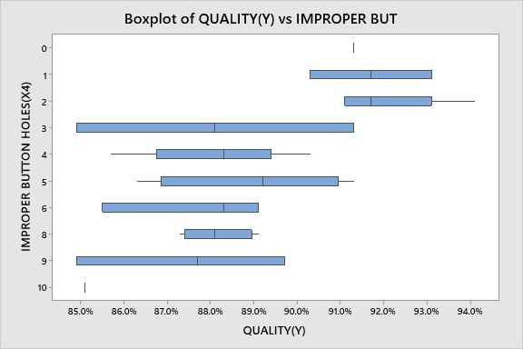
Graphical Output of Test of Equal Variance for Improper Button Holes (X4)
Minitab Session Window output:
Interpretation: From the graph we can observe that, Improper Button Holes has significant impact on Quality. We need to investigate it.
Proprietary and Highly Confidential. 2020 Pursullence Global Business Solutions. All Rights Reserved
Notes:
Steps to perform Test of Equality of Variance continued:
Step 3: Follow this Minitab Path to get the output : Stat>ANOVA>Test for Equal Variances. Run the test and paste the graphical output in the blank space.
Step 4: Write interpretation from the graph.

Slide 51
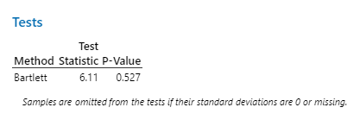
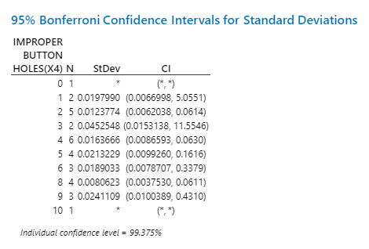
Test Output of Test of Equal Variance for Improper Button Holes (X4)
Minitab Session Window output:
Interpretation: Since p-value is > 0.05, we fail to reject null hypothesis. Hence, we can conclude that, Variances are same i.e. “improper button holes ” has no impact on “quality”
Proprietary and Highly Confidential. 2020 Pursullence Global Business Solutions. All Rights Reserved
Notes:
Steps to perform Test of Equality of Variance continued:
Step 5: Paste the test output in the blank space.
Step 6: Write interpretation and conclusion from the P-value.

Slide 52
Test of Equal Variance (Bartlett’s Test) For Wrong Gradation of Sizes (X5)
Purpose:
Purpose of performing test of equal variance is: To check if Wrong Gradation of Sizes have impact on quality
HYPOTHESIS:
H_{o}: Variances are same i.e. “Wrong Gradation of Sizes ” has no impact on “Quality
H_{a}: Variances are different i.e. “Wrong Gradation of Sizes ” has significant impact on “Quality”
Proprietary and Highly Confidential. 2020 Pursullence Global Business Solutions. All Rights Reserved
Notes:
Steps to perform Test of Equality of Variance:
Step 1: Write the purpose of doing Test of Equality of Variance
Step 2: Write Null and Alternate Hypothesis

Slide 53
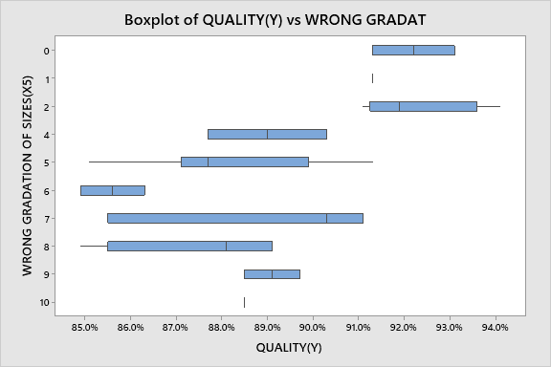
Graphical Output of Test of Equal Variance for Wrong Gradation of Sizes (X5)
Minitab Session Window output:
Interpretation: From the graph we can observe that, Wrong Gradation Of Sizes has significant impact on Quality. We need to investigate it.
Proprietary and Highly Confidential. 2020 Pursullence Global Business Solutions. All Rights Reserved
Notes:
Steps to perform Test of Equality of Variance continued:
Step 3: Follow this Minitab Path to get the output : Stat>ANOVA>Test for Equal Variances. Run the test and paste the graphical output in the blank space.
Step 4: Write interpretation from the graph.

Slide 54

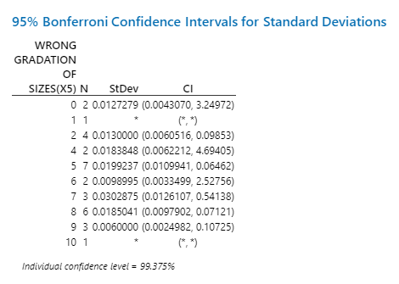
Test Output of Test of Equal Variance for Wrong Gradation of Sizes (X5)
Minitab Session Window output:
Interpretation: Since p-value is > 0.05, we fail to reject null hypothesis. Hence, we can conclude that, Variances are same i.e. “wrong gradation of sizes” has no impact on “quality”
Proprietary and Highly Confidential. 2020 Pursullence Global Business Solutions. All Rights Reserved
Notes:
Steps to perform Test of Equality of Variance continued:
Step 5: Paste the test output in the blank space.
Step 6: Write interpretation and conclusion from the P-value.

Slide 55
Test of Equal Variance (Bartlett’s Test) For Miss out of stitches in between (X6)
Purpose:
Purpose of performing test of equal variance is: To check if Miss out of stiches in between have impact on quality
HYPOTHESIS:
H_{o}: Variances are same i.e. “Miss out of stiches in between” has no impact on “Quality
H_{a}: Variances are different i.e. “Miss out of stiches in between” has significant impact on “Quality”
Proprietary and Highly Confidential. 2020 Pursullence Global Business Solutions. All Rights Reserved
Notes:
Steps to perform Test of Equality of Variance:
Step 1: Write the purpose of doing Test of Equality of Variance
Step 2: Write Null and Alternate Hypothesis

Slide 56
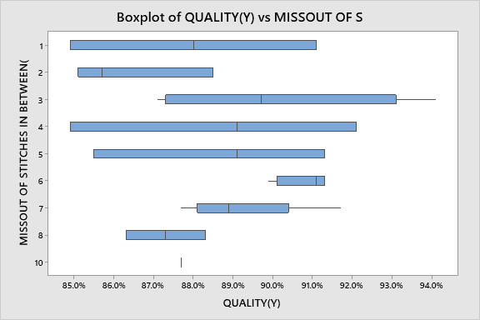
Graphical Output of Test of Equal Variance for Miss out of stitches in between (X6)
Minitab Session Window output:
Interpretation: From the graph we can observe that, Miss Out of Stitches In Between has significant impact on Quality. We need to investigate it.
Proprietary and Highly Confidential. 2020 Pursullence Global Business Solutions. All Rights Reserved
Notes:
Steps to perform Test of Equality of Variance continued:
Step 3: Follow this Minitab Path to get the output : Stat>ANOVA>Test for Equal Variances. Run the test and paste the graphical output in the blank space.
Step 4: Write interpretation from the graph.

Slide 57

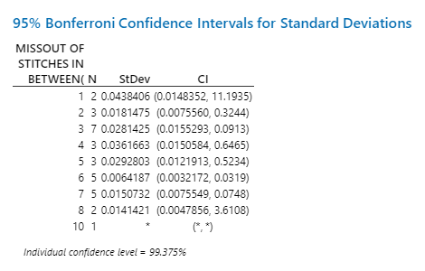
Test Output of Test of Equal Variance for Miss out of stitches in between (X6)
Minitab Session Window output:
Interpretation: Since p-value is > 0.05, we fail to reject null hypothesis. Hence, we can conclude that, Variances are same i.e. “miss out of stitches in between” has no impact on “quality”
Proprietary and Highly Confidential. 2020 Pursullence Global Business Solutions. All Rights Reserved
Notes:
Steps to perform Test of Equality of Variance continued:
Step 5: Paste the test output in the blank space.
Step 6: Write interpretation and conclusion from the P-value.

Slide 58
Test of Equal Variance (F Test) For Wrong stitching techniques used (X7)
Purpose:
Purpose of performing test of equal variance is: To check if Wrong stitching technique used have impact on quality
HYPOTHESIS:
H_{o}: Variances are same i.e. “Wrong stitching technique used ” has no impact on “Quality
H_{a}: Variances are different i.e. “Wrong stitching technique used ” has significant impact on “Quality”
Proprietary and Highly Confidential. 2020 Pursullence Global Business Solutions. All Rights Reserved
Notes:
Steps to perform Test of Equality of Variance:
Step 1: Write the purpose of doing Test of Equality of Variance
Step 2: Write Null and Alternate Hypothesis

Slide 59
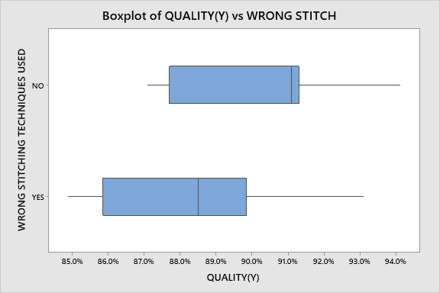
Graphical Output of Test of Equal Variance for Wrong stitching techniques used (X7)
Minitab Session Window output:
Interpretation: From the graph we can observe that, Wrong Stitching Technique Used has significant impact on Quality. We need to investigate it.
Proprietary and Highly Confidential. 2020 Pursullence Global Business Solutions. All Rights Reserved
Notes:
Steps to perform Test of Equality of Variance continued:
Step 3: Follow this Minitab Path to get the output : Stat>ANOVA>Test for Equal Variances. Run the test and paste the graphical output in the blank space.
Step 4: Write interpretation from the graph.

Slide 60
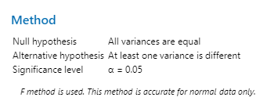
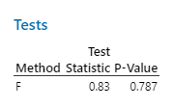
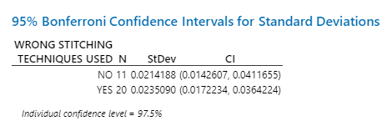
Test Output of Test of Equal Variance for Wrong stitching techniques used (X7)
Minitab Session Window output:
Interpretation: Since p-value is > 0.05, we fail to reject null hypothesis. Hence, we can conclude that, Variances are same i.e. “wrong stitching techniques used” has no impact on “quality”
Proprietary and Highly Confidential. 2020 Pursullence Global Business Solutions. All Rights Reserved
Notes:
Steps to perform Test of Equality of Variance continued:
Step 5: Paste the test output in the blank space.
Step 6: Write interpretation and conclusion from the P-value.

Slide 61
Test of Equal Variance (Bartlett’s Test) For Wrong size packaging (X8)
Purpose:
Purpose of performing test of equal variance is : To check if Wrong size packaging have impact on quality
HYPOTHESIS:
H_{o}: Variances are same i.e. “Wrong size packaging ” has no impact on “Quality
H_{a}: Variances are different i.e. “Wrong size packaging ” has significant impact on “Quality”
Proprietary and Highly Confidential. 2020 Pursullence Global Business Solutions. All Rights Reserved
Notes:
Steps to perform Test of Equality of Variance:
Step 1: Write the purpose of doing Test of Equality of Variance
Step 2: Write Null and Alternate Hypothesis

Slide 62
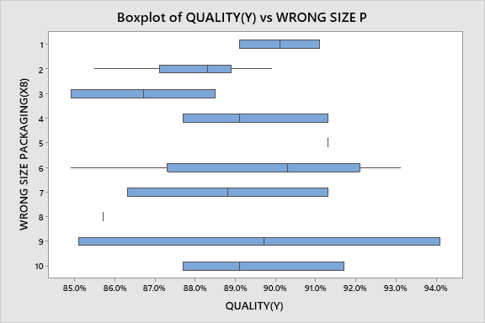
Graphical Output of Test of Equal Variance for Wrong size packaging (X8)
Minitab Session Window output:
Interpretation: From the graph we can observe that, Wrong Size Packaging has significant impact on Quality. We need to investigate it.
Proprietary and Highly Confidential. 2020 Pursullence Global Business Solutions. All Rights Reserved
Notes:
Steps to perform Test of Equality of Variance continued:
Step 3: Follow this Minitab Path to get the output : Stat>ANOVA>Test for Equal Variances. Run the test and paste the graphical output in the blank space.
Step 4: Write interpretation from the graph.

Slide 63

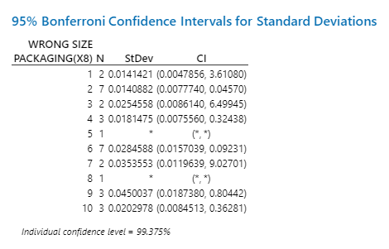
Test Output of Test of Equal Variance for Wrong size packaging (X8)
Minitab Session Window output:
Interpretation: Since p-value is > 0.05, we fail to reject null hypothesis. Hence, we can conclude that, Variances are same i.e. “wrong size packaging” has no impact on “quality”
Proprietary and Highly Confidential. 2020 Pursullence Global Business Solutions. All Rights Reserved
Notes:
Steps to perform Test of Equality of Variance continued:
Step 5: Paste the test output in the blank space.
Step 6: Write interpretation and conclusion from the P-value.

Slide 64
Test of Equal Variance (Bartlett’s Test) For Wrong colour combination (X9)
Purpose:
Purpose of performing test of equal variance is: To check if Wrong color combination have impact on quality
HYPOTHESIS:
H_{o}: Variances are same i.e. “Wrong color combination ” has no impact on “Quality
H_{a}: Variances are different i.e. “Wrong color combination ” has significant impact on “Quality”
Proprietary and Highly Confidential. 2020 Pursullence Global Business Solutions. All Rights Reserved
Notes:
Steps to perform Test of Equality of Variance:
Step 1: Write the purpose of doing Test of Equality of Variance
Step 2: Write Null and Alternate Hypothesis

Slide 65
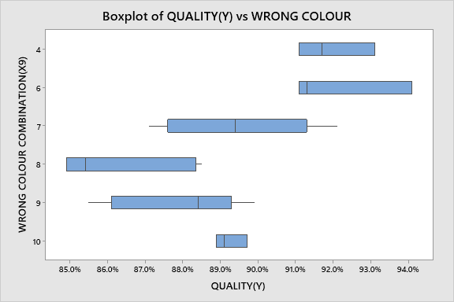
Graphical Output of Test of Equal Variance for Wrong colour combination (X9)
Minitab Session Window output:
Interpretation: From the graph we can observe that, Wrong Color Combination has significant impact on Quality. We need to investigate it.
Proprietary and Highly Confidential. 2020 Pursullence Global Business Solutions. All Rights Reserved
Notes:
Steps to perform Test of Equality of Variance continued:
Step 3: Follow this Minitab Path to get the output : Stat>ANOVA>Test for Equal Variances. Run the test and paste the graphical output in the blank space.
Step 4: Write interpretation from the graph.

Slide 66
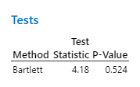
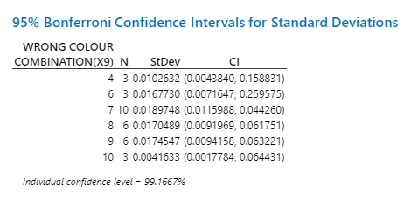
Test Output of Test of Equal Variance for Wrong colour combination (X9)
Minitab Session Window output:
Interpretation: Since p-value is > 0.05, we fail to reject null hypothesis. Hence, we can conclude that, Variances are same i.e. “wrong color combination” has no impact on “quality”
Proprietary and Highly Confidential. 2020 Pursullence Global Business Solutions. All Rights Reserved
Notes:
Steps to perform Test of Equality of Variance continued:
Step 5: Paste the test output in the blank space.
Step 6: Write interpretation and conclusion from the P-value.

Slide 67
Test of Equal Variance (Bartlett’s Test) For Improper label dimensions (X10)
Purpose:
Purpose of performing test of equal variance is: To check if Improper label dimensions have impact on quality
HYPOTHESIS:
H_{o}: Variances are same i.e. “Improper label dimensions ” has no impact on “Quality
H_{a}: Variances are different i.e. “Improper label dimensions ” has significant impact on “Quality”
Proprietary and Highly Confidential. 2020 Pursullence Global Business Solutions. All Rights Reserved
Notes:
Steps to perform Test of Equality of Variance:
Step 1: Write the purpose of doing Test of Equality of Variance
Step 2: Write Null and Alternate Hypothesis

Slide 68
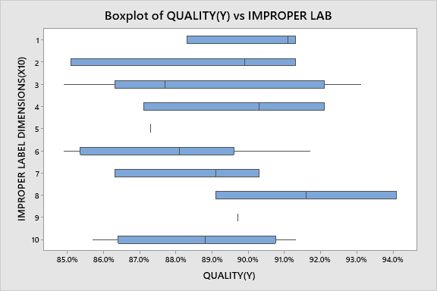
Graphical Output of Test of Equal Variance for Improper label dimensions (X10)
Minitab Session Window output:
Interpretation: From the graph we can observe that, Improper Label Dimensions has significant impact on Quality. We need to investigate it.
Proprietary and Highly Confidential. 2020 Pursullence Global Business Solutions. All Rights Reserved
Notes:
Steps to perform Test of Equality of Variance continued:
Step 3: Follow this Minitab Path to get the output : Stat>ANOVA>Test for Equal Variances. Run the test and paste the graphical output in the blank space.
Step 4: Write interpretation from the graph.

Slide 69

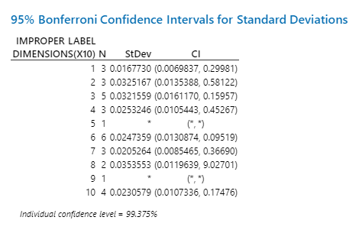
Test Output of Test of Equal Variance for Improper label dimensions (X10)
Minitab Session Window output:
Interpretation: Since p-value is > 0.05, we fail to reject null hypothesis. Hence, we can conclude that, Variances are same i.e. “improper label dimensions” has no impact on “quality”
Proprietary and Highly Confidential. 2020 Pursullence Global Business Solutions. All Rights Reserved
Notes:
Steps to perform Test of Equality of Variance continued:
Step 5: Paste the test output in the blank space.
Step 6: Write interpretation and conclusion from the P-value.

Slide 70
Result of Test of Equal Variance
Summary table of Test of equal variance for Y and all X’s (More than 2 levels)
SR. NO. | Y | X | P-VALUE | INTERPRETATION
1 | QUALITY | FAULTY ZIPPERS (X1) | 0.886 | Since p-value is > 0.05, we fail to reject null hypothesis. Hence, we can conclude that, Variances are same i.e. “Faulty zippers” has no impact on “quality’’
2 | QUALITY | LOOSE BUTTONS (X2) | 0.236 | Since p-value is > 0.05, we fail to reject null hypothesis. Hence, we can conclude that, Variances are same i.e. “ loose buttons ” has no impact on “quality
3 | QUALITY | IRREGULAR HEMMING (X3) | 0.697 | Since p-value is > 0.05, we fail to reject null hypothesis. Hence, we can conclude that, Variances are same i.e. “ irregular hemming ” has no impact on “quality
4 | QUALITY | IMPROPER BUTTON HOLES (X4) | 0.527 | Since p-value is > 0.05, we fail to reject null hypothesis. Hence, we can conclude that, Variances are same i.e. “ improper button holes ” has no impact on “quality
5 | QUALITY | WRONG GRADATION OF SIZES (X5) | 0.718 | Since p-value is > 0.05, we fail to reject null hypothesis. Hence, we can conclude that, Variances are same i.e. ‘’ wrong gradation of sizes ” has no impact on “quality
Proprietary and Highly Confidential. 2020 Pursullence Global Business Solutions. All Rights Reserved
Notes:
Prepare a summary table of Test of equality of variances. Write P value and interpretation in the provided columns.

Slide 71
Result of Test of Equal Variance
Summary table of Test of equal variance for Y and all X’s (More than 2 levels)
SR. NO. | Y | X | P-VALUE | INTERPRETATION
6 | QUALITY | MISS OUT OF STITCHES IN BETWEEN (X6) | 0.219 | Since p-value is > 0.05, we fail to reject null hypothesis. Hence, we can conclude that, Variances are same i.e. “ miss out of stitches in between ” has no impact on “quality
7 | QUALITY | WRONG SIZE PACKAGING (X8) | 0.787 | Since p-value is > 0.05, we fail to reject null hypothesis. Hence, we can conclude that, Variances are same i.e. “ wrong size packaging” has no impact on “quality
8 | QUALITY | WRONG COLOUR COMBINATION (X9) | 0.637 | Since p-value is > 0.05, we fail to reject null hypothesis. Hence, we can conclude that, Variances are same i.e. “ wrong color combination” has no impact on “quality
9 | QUALITY | IMPROPER LABEL DIMENSIONS (X10) | 0.524 | Since p-value is > 0.05, we fail to reject null hypothesis. Hence, we can conclude that, Variances are same i.e. “ improper label dimensions ” has no impact on “quality
Proprietary and Highly Confidential. 2020 Pursullence Global Business Solutions. All Rights Reserved
Notes:
Prepare a summary table of Test of equality of variances. Write P value and interpretation in the provided columns.

Slide 72
Test of Equal Variance
Summary table of Test of equal variance for Y and all X’s (With two levels)
SR. NO. | Y | X | P-VALUE | INTERPRETATION
10 | QUALITY | WRONG STITCHING TECHNIQUES USED (X7) | 0.983 | Since p-value is > 0.05, we fail to reject null hypothesis. Hence, we can conclude that, Variances are same i.e. “improper label dimensions” has no impact on “quality”
Proprietary and Highly Confidential. 2020 Pursullence Global Business Solutions. All Rights Reserved
Notes:
Prepare a summary table of Test of equality of variances. Write P value and interpretation in the provided columns.

Slide 73
Important Note 3:
If p value is < 0.05 then we don’t need to go for mean tests i.e 2 sample t test or ANOVA, BUT… if p value > 0.05 then we need to further perform mean tests.
Hint:
If Y – Continuous, X – Discrete (More than 2 levels of X) Then use One Way ANOVA
If Y – Continuous, X – Discrete (2 levels of X) Then use Two sample t test
Proprietary and Highly Confidential. 2020 Pursullence Global Business Solutions. All Rights Reserved
Notes:
Read the slide- Important Note 2: Selection of test to test the means.

Slide 74
One-Way ANOVA
Y (Quality) – X1 (Faulty Zippers)
Purpose:
Purpose of performing one way ANOVA is: The project team believes that there are potential “X’s” that have impact on “Y”
Hypothesis:
H_{o}: “Faulty Zippers” has no impact on “Quality”.
VS
H_{a}: “Faulty Zippers” has impact on “Quality”.
Proprietary and Highly Confidential. 2020 Pursullence Global Business Solutions. All Rights Reserved
Notes:
Steps to perform One Way ANOVA:
Step 1: Write the purpose of doing One Way ANOVA
Step 2: Write Null and Alternate Hypothesis

Slide 75
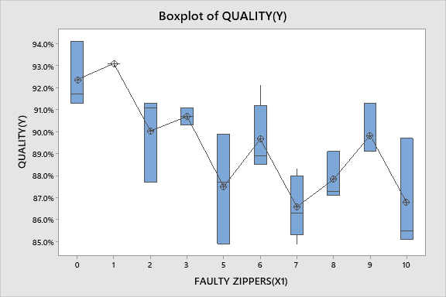
Graphical Output of One-Way ANOVA
Minitab Session Window output:
Interpretation: The shape and spread of box plots for faulty zippers are not equal There are no outliners.
Proprietary and Highly Confidential. 2020 Pursullence Global Business Solutions. All Rights Reserved
Notes:
Steps to perform One Way ANOVA Continued:
Step 3: Follow this Minitab Path to get the output : Stat-ANOVA-One-Way. Run the test and paste the graphical output in the blank space.
Step 4: Write interpretation from the graph.

Slide 76
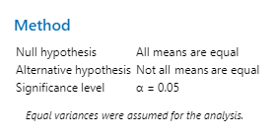

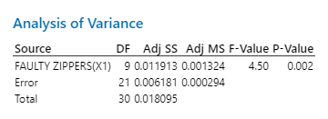
ANOVA Test Output
Minitab Session Window output:
Interpretation: Since the p-value is < 0.05, Impact of “Faulty zippers” on “Quality” is statistically significant.
Proprietary and Highly Confidential. 2020 Pursullence Global Business Solutions. All Rights Reserved
Notes:
Steps to perform One Way ANOVA Continued:
Step 5: Paste the test output in the blank space.
Step 6: Write interpretation and conclusion from the P-value.

Slide 77
One-Way ANOVA
Y (Quality) – X2 (LOOSE BUTTONS)
Purpose:
Purpose of performing one way ANOVA is: The project team believes that there are potential “X’s” that have impact on “Y”
Hypothesis:
H_{o}: “Loose Buttons” has no impact on “Quality”.
VS
H_{a}: “Loose Buttons” has impact on “Quality”.
Proprietary and Highly Confidential. 2020 Pursullence Global Business Solutions. All Rights Reserved
Notes:
Steps to perform One Way ANOVA:
Step 1: Write the purpose of doing One Way ANOVA
Step 2: Write Null and Alternate Hypothesis

Slide 78
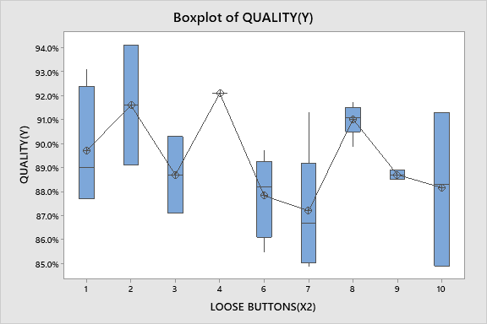
Graphical Output of One-Way ANOVA
Minitab Session Window output:
Interpretation: The shape and spread of box plots for loose buttons are not equal There are no outliners.
Proprietary and Highly Confidential. 2020 Pursullence Global Business Solutions. All Rights Reserved
Notes:
Steps to perform One Way ANOVA Continued:
Step 3: Follow this Minitab Path to get the output : Stat-ANOVA-One-Way. Run the test and paste the graphical output in the blank space.
Step 4: Write interpretation from the graph.

Slide 79

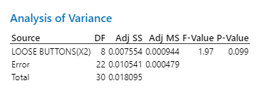
ANOVA Test Output
Minitab Session Window output:
Interpretation: Since the p-value is > 0.05, Impact of “Loose Buttons” on “Quality” is statistically insignificant.
Proprietary and Highly Confidential. 2020 Pursullence Global Business Solutions. All Rights Reserved
Notes:
Steps to perform One Way ANOVA Continued:
Step 5: Paste the test output in the blank space.
Step 6: Write interpretation and conclusion from the P-value.

Slide 80
One-Way ANOVA
Y (Quality) – X3 (IRREGULAR HEMMING)
Purpose:
Purpose of performing one way ANOVA is: The project team believes that there are potential “X’s” that have impact on “Y”
Hypothesis:
H_{o}: “Irregular Heming” has no impact on “Quality”.
VS
H_{a}: “Irregular Heming” has impact on “Quality”.
Proprietary and Highly Confidential. 2020 Pursullence Global Business Solutions. All Rights Reserved
Notes:
Steps to perform One Way ANOVA:
Step 1: Write the purpose of doing One Way ANOVA
Step 2: Write Null and Alternate Hypothesis

Slide 81
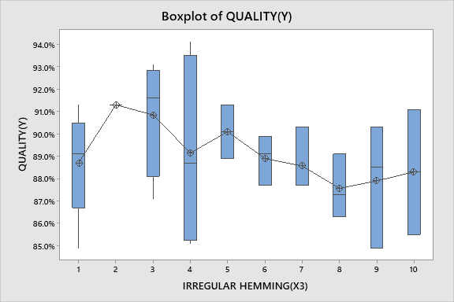
Graphical Output of One-Way ANOVA
Minitab Session Window output:
Interpretation: The shape and spread of box plots for irregular hemming are not equal There are no outliners.
Proprietary and Highly Confidential. 2020 Pursullence Global Business Solutions. All Rights Reserved
Notes:
Steps to perform One Way ANOVA Continued:
Step 3: Follow this Minitab Path to get the output : Stat-ANOVA-One-Way. Run the test and paste the graphical output in the blank space.
Step 4: Write interpretation from the graph.

Slide 82


ANOVA Test Output
Minitab Session Window output:
Interpretation: Since the p-value is >0.05, Impact of “Irregular Hemming” on “Quality” is statistically insignificant.
Proprietary and Highly Confidential. 2020 Pursullence Global Business Solutions. All Rights Reserved
Notes:
Steps to perform One Way ANOVA Continued:
Step 5: Paste the test output in the blank space.
Step 6: Write interpretation and conclusion from the P-value.

Slide 83
One-Way ANOVA
Y (Quality) – X4 (IMPROPER BUTTON HOLES)
Purpose:
Purpose of performing one way ANOVA is: The project team believes that there are potential “X’s” that have impact on “Y”
Hypothesis:
H_{o}: “Improper Button Holes” has no impact on “Quality”.
VS
H_{a}: “Improper Button Holes” has impact on “Quality”.
Proprietary and Highly Confidential. 2020 Pursullence Global Business Solutions. All Rights Reserved
Notes:
Steps to perform One Way ANOVA:
Step 1: Write the purpose of doing One Way ANOVA
Step 2: Write Null and Alternate Hypothesis

Slide 84

Graphical Output of One-Way ANOVA
Minitab Session Window output:
Interpretation: The shape and spread of box plots for improper button holes are not equal There are no outliners.
Proprietary and Highly Confidential. 2020 Pursullence Global Business Solutions. All Rights Reserved
Notes:
Steps to perform One Way ANOVA Continued:
Step 3: Follow this Minitab Path to get the output : Stat-ANOVA-One-Way. Run the test and paste the graphical output in the blank space.
Step 4: Write interpretation from the graph.

Slide 85


ANOVA Test Output
Minitab Session Window output:
Interpretation: Since the p-value is < 0.05, Impact of “Improper Button Holes” on “Quality” is statistically significant.
Proprietary and Highly Confidential. 2020 Pursullence Global Business Solutions. All Rights Reserved
Notes:
Steps to perform One Way ANOVA Continued:
Step 5: Paste the test output in the blank space.
Step 6: Write interpretation and conclusion from the P-value.

Slide 86
One-Way ANOVA
Y (Quality) – X5 (WRONG GRADATION OF SIZES)
Purpose:
Purpose of performing one way ANOVA is: The project team believes that there are potential “X’s” that have impact on “Y”
Hypothesis:
H_{o}: “Wrong Gradation Of Sizes” has no impact on “Quality”.
VS
H_{a} : “Wrong Gradation Of Sizes” has impact on “Quality”.
Proprietary and Highly Confidential. 2020 Pursullence Global Business Solutions. All Rights Reserved
Notes:
Steps to perform One Way ANOVA:
Step 1: Write the purpose of doing One Way ANOVA
Step 2: Write Null and Alternate Hypothesis

Slide 87

Graphical Output of One-Way ANOVA
Minitab Session Window output:
Interpretation: The shape and spread of box plots for wrong gradation of sizes are not equal There are no outliners.
Proprietary and Highly Confidential. 2020 Pursullence Global Business Solutions. All Rights Reserved
Notes:
Steps to perform One Way ANOVA Continued:
Step 3: Follow this Minitab Path to get the output : Stat-ANOVA-One-Way. Run the test and paste the graphical output in the blank space.
Step 4: Write interpretation from the graph.

Slide 88


ANOVA Test Output
Minitab Session Window output:
Interpretation: Since the p-value is > 0.05, Impact of “Wrong Gradation Of Sizes” on “Quality” is statistically insignificant
Proprietary and Highly Confidential. 2020 Pursullence Global Business Solutions. All Rights Reserved
Notes:
Steps to perform One Way ANOVA Continued:
Step 5: Paste the test output in the blank space.
Step 6: Write interpretation and conclusion from the P-value.

Slide 89
One-Way ANOVA
Y (Quality) – X6 (MISS OUT OF STITCHES IN BETWEEN)
Purpose:
Purpose of performing one way ANOVA is: The project team believes that there are potential “X’s” that have impact on “Y”
Hypothesis:
H_{o}: “Miss Out Of Stiches In Between” has no impact on “Quality”.
VS
H_{a}: “Miss Out Of Stiches In Between” has no impact on “Quality”.
Proprietary and Highly Confidential. 2020 Pursullence Global Business Solutions. All Rights Reserved
Notes:
Steps to perform One Way ANOVA:
Step 1: Write the purpose of doing One Way ANOVA
Step 2: Write Null and Alternate Hypothesis

Slide 90
Graphical Output of One-Way ANOVA
Minitab Session Window output:
Interpretation: The shape and spread of box plots for Wrong gradation Of Sizes are not equal There are no outliners.
Proprietary and Highly Confidential. 2020 Pursullence Global Business Solutions. All Rights Reserved
Notes:
Steps to perform One Way ANOVA Continued:
Step 3: Follow this Minitab Path to get the output : Stat-ANOVA-One-Way. Run the test and paste the graphical output in the blank space.
Step 4: Write interpretation from the graph.

Slide 91


ANOVA Test Output
Minitab Session Window output:
Interpretation: Since the p-value is < 0.05, Impact of “Wrong Gradation Of Sizes” on “Quality” is statistically significant
Proprietary and Highly Confidential. 2020 Pursullence Global Business Solutions. All Rights Reserved
Notes:
Steps to perform One Way ANOVA Continued:
Step 5: Paste the test output in the blank space.
Step 6: Write interpretation and conclusion from the P-value.

Slide 92
Two Sample t Test
Y (Quality) – X7 (WRONG STITCHING TECHNIQUES USED)
Purpose:
Purpose of performing Two sample t test is: Compares the means of Y across two levels of X
Hypothesis:
H_{o}: “Wrong stitching techniques used ” has no impact on “Quality of shirts ”
VS
H_{a}: “ Wrong stitching techniques used” has impact on “Quality of shirts ”
Proprietary and Highly Confidential. 2020 Pursullence Global Business Solutions. All Rights Reserved
Notes:
Steps to perform Two Sample t test:
Step 1: Write the purpose of doing Two sample t test.
Step 2: Write Null and Alternate Hypothesis

Slide 93

Graphical Output of Two sample t test
Minitab Session Window output:
Interpretation: The shape and spread of box plots for both Wrong Stitching Technique Techniques Used for no is slightly higher than yes
Proprietary and Highly Confidential. 2020 Pursullence Global Business Solutions. All Rights Reserved
Notes:
Steps to perform Two sample t test Continued:
Step 3: Follow this Minitab Path to get the output : Stat>Basic Statistics>2 Sample t test. Run the test and paste the graphical output in the blank space.
Step 4: Write interpretation from the graph.

Slide 94



Two sample t Test Output
Minitab Session Window output:
Interpretation: Since the p-value is < 0.05, we fail to reject null hypothesis. Hence, we can infer that, “Wrong stitching technique used” has impact on “Quality”.
Proprietary and Highly Confidential. 2020 Pursullence Global Business Solutions. All Rights Reserved
Notes:
Steps to perform Two sample t test Continued:
Step 5: Paste the test output in the blank space.
Step 6: Write interpretation and conclusion from the P-value.

Slide 95
One-Way ANOVA
Y (Quality) – X8 (WRONG SIZE PACKAGING)
Purpose:
Purpose of performing one way ANOVA is: The project team believes that there are potential “X’s” that have impact on “Y”
Hypothesis:
H_{o}: “Wrong Size Packaging” has no impact on “Quality
VS
H_{a}: “Wrong Size Packaging” has no impact on “Quality
Proprietary and Highly Confidential. 2020 Pursullence Global Business Solutions. All Rights Reserved
Notes:
Steps to perform One Way ANOVA:
Step 1: Write the purpose of doing One Way ANOVA
Step 2: Write Null and Alternate Hypothesis

Slide 96

Graphical Output of One-Way ANOVA
Minitab Session Window output:
Interpretation: The shape and spread of box plots for wrong size packaging are not equal There are no outliners.
Proprietary and Highly Confidential. 2020 Pursullence Global Business Solutions. All Rights Reserved
Notes:
Steps to perform One Way ANOVA Continued:
Step 3: Follow this Minitab Path to get the output : Stat-ANOVA-One-Way. Run the test and paste the graphical output in the blank space.
Step 4: Write interpretation from the graph.

Slide 97


ANOVA Test Output
Minitab Session Window output:
Interpretation: Since the p-value is > 0.05, Impact of “Wrong Size Packaging” on “Quality” is statistically insignificant
Proprietary and Highly Confidential. 2020 Pursullence Global Business Solutions. All Rights Reserved
Notes:
Steps to perform One Way ANOVA Continued:
Step 5: Paste the test output in the blank space.
Step 6: Write interpretation and conclusion from the P-value.

Slide 98
One-Way ANOVA
Y (Quality) – X9 (WRONG COLOUR COMBINATION)
Purpose:
Purpose of performing one way ANOVA is: The project team believes that there are potential “X’s” that have impact on “Y”
Hypothesis:
H_{o}: “Wrong Color Combination” has no impact on “Quality
VS
H_{a}: “Wrong Color Combination” has no impact on “Quality
Proprietary and Highly Confidential. 2020 Pursullence Global Business Solutions. All Rights Reserved
Notes:
Steps to perform One Way ANOVA:
Step 1: Write the purpose of doing One Way ANOVA
Step 2: Write Null and Alternate Hypothesis

Slide 99

Graphical Output of One-Way ANOVA
Minitab Session Window output:
Interpretation: The shape and spread of box plots for wrong color combination are not equal There are no outliners.
Proprietary and Highly Confidential. 2020 Pursullence Global Business Solutions. All Rights Reserved
Notes:
Steps to perform One Way ANOVA Continued:
Step 3: Follow this Minitab Path to get the output : Stat-ANOVA-One-Way. Run the test and paste the graphical output in the blank space.
Step 4: Write interpretation from the graph.

Slide 100


ANOVA Test Output
Minitab Session Window output:
Interpretation: Since the p-value is < 0.05, Impact of “Wrong Color Combination” on “Quality” is statistically significant
Proprietary and Highly Confidential. 2020 Pursullence Global Business Solutions. All Rights Reserved
Notes:
Steps to perform One Way ANOVA Continued:
Step 5: Paste the test output in the blank space.
Step 6: Write interpretation and conclusion from the P-value.

Slide 101
One-Way ANOVA
Y (Quality) – X10 (IMPROPER LABEL DIMENSIONS)
Purpose:
Purpose of performing one way ANOVA is: The project team believes that there are potential “X’s” that have impact on “Y”
Hypothesis:
H_{o}: “Improper Label Combination” has no impact on “Quality
VS
H_{a}: “Improper Label Combination” has impact on “Quality
Proprietary and Highly Confidential. 2020 Pursullence Global Business Solutions. All Rights Reserved
Notes:
Steps to perform One Way ANOVA:
Step 1: Write the purpose of doing One Way ANOVA
Step 2: Write Null and Alternate Hypothesis

Slide 102

Graphical Output of One-Way ANOVA
Minitab Session Window output:
Interpretation: The shape and spread of box plots for improper label dimensions are not equal There are no outliners.
Proprietary and Highly Confidential. 2020 Pursullence Global Business Solutions. All Rights Reserved
Notes:
Steps to perform One Way ANOVA Continued:
Step 3: Follow this Minitab Path to get the output : Stat-ANOVA-One-Way. Run the test and paste the graphical output in the blank space.
Step 4: Write interpretation from the graph.

Slide 103


ANOVA Test Output
Minitab Session Window output:
Interpretation: Since the p-value is >0.05, Impact of “Improper Label Dimensions” on “Quality” is statistically insignificant
Proprietary and Highly Confidential. 2020 Pursullence Global Business Solutions. All Rights Reserved
Notes:
Steps to perform One Way ANOVA Continued:
Step 5: Paste the test output in the blank space.
Step 6: Write interpretation and conclusion from the P-value.

Slide 104
Result of Mean Tests
Summary table of Test of equal variance for Y and all X’s
SR. NO. | Y | X | P-VALUE | INTERPRETATION
1 | % QUALITY Score Per Day | Faulty Zippers | 0.002 | Since the p-value is < 0.05, Impact of “Faulty zippers” on “Quality” is statistically significant.
2 | % QUALITY Score Per Day | Loose Buttons | 0.099 | Since the p-value is > 0.05, Impact of “Loose Buttons” on “Quality” is statistically insignificant.
3 | % QUALITY Score Per Day | Irregular Hemming | 0.832 | Since the p-value is >0.05, Impact of “Irregular Hemming” on “Quality” is statistically insignificant.
4 | % QUALITY Score Per Day | Improper Button Holes | 0.017 | Since the p-value is < 0.05, Impact of “Improper Button Holes” on “Quality” is statistically significant
5 | % QUALITY Score Per Day | Wrong Gradation of Sizes | 0.007 | Since the p-value is < 0.05, Impact of “Wrong Gradation Of Sizes” on “Quality” is statistically significant
Proprietary and Highly Confidential. 2020 Pursullence Global Business Solutions. All Rights Reserved
Notes:
Prepare a summary table of Mean Tests. Write P value and interpretation in the provided columns.

Slide 105
Result of Mean Tests
Summary table of Test of equal variance for Y and all X’s
SR. NO. | Y | X | P-VALUE | INTERPRETATION
6 | % QUALITY Score Per Day | Miss out of stiches in between | 0.402 | Since the p-value is > 0.05, Impact of “Miss Out Of Stiches” on “Quality” is statistically insignificant
7 | % QUALITY Score Per Day | Wrong stitching technique used | 0.022 | Since the p-value is < 0.05, we fail to reject null hypothesis. Hence, we can infer that, “Wrong stitching technique used” has impact on “Quality” and is statistically significant.
8 | % QUALITY Score Per Day | Wrong size packaging | 0.659 | Since the p-value is > 0.05, Impact of “Wrong Size Packaging” on “Quality” is statistically insignificant
9 | % QUALITY Score Per Day | Wrong color combination | 0.000 | Since the p-value is < 0.05, Impact of “Wrong Color Combination” on “Quality” is statistically significant
10 | % QUALITY Score Per Day | Improper label combinations | 0.850 | Since the p-value is >0.05, Impact of “Improper Label Dimensions” on “Quality” is statistically insignificant
Proprietary and Highly Confidential. 2020 Pursullence Global Business Solutions. All Rights Reserved
Notes:
Prepare a summary table of Mean Tests. Write P value and interpretation in the provided columns.

Slide 106
SUMMARY TABLE
Significant Causes List from Analyze Phase
SR. NO. | Y (OUTCOME) | X (CAUSES)
1 | % QUALITY Score Per Day | Faulty Zippers(X1)
2 | % QUALITY Score Per Day | Improper Button Holes(X4)
3 | % QUALITY Score Per Day | Wrong Gradation of Sizes(X5)
4 | % QUALITY Score Per Day | Wrong stitching technique used(X7)
5 | % QUALITY Score Per Day | Wrong color combination(X9)
Proprietary and Highly Confidential. 2020 Pursullence Global Business Solutions. All Rights Reserved
Notes:
Prepare a table of significant causes identified in Analyze Phase.

Slide 107
IMPROVE PHASE
Proprietary and Highly Confidential. 2020 Pursullence Global Business Solutions. All Rights Reserved

Slide 108


Solution Brainstorming
Click here
Proprietary and Highly Confidential. 2020 Pursullence Global Business Solutions. All Rights Reserved
Notes:
Note: Solution Brainstorming is done by Pursullence.

Slide 109
Solution Refining
Click here
Significant X's | Ideas | Impact | Cost Effective | Feasible to Deploy | Authority Consent | Solutions Priority Index
1. Faulty Zippers | Provide adequate training to the operators | 3 | 1 | 2 | 1 | 6
 | Replace faulty zippers with a new one. | 3 | 2 | 2 | 3 | 36
 | Improve supervision | 2 | 1 | 1 | 2 | 4
 | Inform suppliers about faulty zippers | 2 | 3 | 2 | 2 | 24
2. Improper Button Holes | Regular maintenance of button holes machine should be done | 3 | 3 | 1 | 2 | 18
 | Rethread machine and maintain proper thread tensions. Make sure the thread passes through the tension discs | 2 | 2 | 2 | 2 | 16
 | Provide adequate training to the operators | 3 | 2 | 2 | 3 | 36
 | Rethread the incorrectly threaded bobbins | 3 | 2 | 1 | 2 | 12
 | Improve supervision | 3 | 2 | 1 | 1 | 6
 | Trained operators sufficiently | 3 | 2 | 2 | 2 | 24
3. Wrong Gradation Of Sizes | Proper callibrated measurement tool to be used | 3 | 1 | 2 | 2 | 12
 | Carefully follow the marked line during sewing | 3 | 1 | 2 | 2 | 12
 | Improve supervision | 3 | 2 | 2 | 2 | 24
 | Trained operators sufficiently | 3 | 2 | 1 | 1 | 6
 | Provide adequate training to the operator | 3 | 2 | 2 | 2 | 24
4. Wrong Stitching Techniques Used | Rethread the incorrectly threaded bobbins | 3 | 3 | 2 | 1 | 18
 | Carefully follow the marked line during sewing | 3 | 2 | 2 | 2 | 24
 | Improve supervision | 3 | 3 | 1 | 1 | 9
 | Trained operators sufficiently | 3 | 2 | 2 | 2 | 24
 | Provide adequate training to the operator | 3 | 2 | 2 | 1 | 12
5. Wrong Colour Combination | Rethread the incorrectly threaded bobbins | 3 | 2 | 2 | 2 | 24
 | Improve supervision | 3 | 3 | 2 | 2 | 36
 | Trained operators sufficiently | 3 | 2 | 2 | 1 | 12
Proprietary and Highly Confidential. 2020 Pursullence Global Business Solutions. All Rights Reserved
Notes:
Steps to complete Solution Refining table:
Step 1: Excel file with blank template of solution refining is embedded in this sheet. Download the excel sheet.
Step 2: Read the ideas given in the table.
Step 3: You have to give numbers from 1 to 3 (i.e. low to high) for Impact , cost effective, Feasibility to deploy and authority consent and then automatically it will compute Solutions priority index.
Step 4: In Solution priority index, green colour means, those ideas are comparatively easy to implement. (Try to get at-least one solution for each cause, which we need to use in control phase)

Slide 110
Pilot Phase Planning and Data Collection
PHASE I : SOLUTIONS SENSITIZATION ( 1st FEB 2020 to 10th FEB 2020)
From process 1 of Account 1 of Textile. Corp., bottom 10% resources are planned to analyze based on historical data. Pilot project will be implemented upon bottom 10% performers from each experience tenure level.
Project problem will be discussed with them, important causes and probable solutions need to be communicated to them in a small session. Probable challenges to implement solutions will be discussed and 10 days timeline from 1st FEB 2020 to 10th FEB 2020) will be allocated for solutions sensitization.
Process TL will track the challenges to deploy solutions and best practices sharing on daily basis.
LSSGB project leader and AM will review solution implementation status on alternate days and ensure smooth implementation of solutions and will provide adequate support.
PHASE II : ASSESSMENT OF SOLUTION STANDARDIZATION : ( 11th FEB 2020 to 12th FEB 2020 )
1. On 11th FEB 2020, a small test will be conducted among pilot participants to assess their understanding of new changes or solutions. If test will assure that > 90% participants’ scores are satisfactory, then we will confirm that solution standardization is accomplished. Update will be communicated to authorities/process owner.
PHASE III : IMPROVE PHASE DATA COLLECTION AND IMPROVEMENT VALIDATION : (20th FEB 2020 until 20th MARCH 2020 )
Improve phase data collection will commence from Monday, (20th FEB 2020 until 20th MARCH 2020) If Improvement will be achieved, it will be validated based on adequate statistical tests and capability analysis. Results will be shared with authorities and improvement will be assessed monetarily.
Proprietary and Highly Confidential. 2020 Pursullence Global Business Solutions. All Rights Reserved
Notes:
Note: Pilot Phase Planning and Data Collection is done by Pursullence.

Slide 111


Data Collection for Improve Phase
Click here
Proprietary and Highly Confidential. 2020 Pursullence Global Business Solutions. All Rights Reserved
Notes:
Improve Phase – % Quality Score (Per Day) Data.
-Excel file is embedded on this slide.
-In this excel, data for % Quality Score(Per Day) and number of incidences are given for significant causes obtained in analyze phase.
-Use this data for further analysis of improve phase.

Slide 112

Stability Analysis
Purpose: To check whether Improve phase data is stable or not. (For Continuous Y - % Quality per day
Minitab Session Window output:
Interpretation: p-value for all Clustering, Mixtures, Trends & Oscillations are greater than 0.05, Data is stable
Proprietary and Highly Confidential. 2020 Pursullence Global Business Solutions. All Rights Reserved
Notes:
Steps to draw a Run Chart:
Step 1: Draw Run chart. (Minitab Path: Stat> Control Control> Run Chart)
Step 2: Observe the p- values of parameters Clustering, Mixtures, Trends & Oscillations from the Run Chart. (You can refer previous TAT project)
Step 3: Write the interpretation about the stability of data.

Slide 113

Normality Analysis
Purpose: To check the Normality of % Quality of improve phase (For Continuous Y - % Quality per day)
Minitab Session Window output:
Interpretation: There are no outliers on the graph and P-Value is greater than 0.05 which indicates normality.
Proprietary and Highly Confidential. 2020 Pursullence Global Business Solutions. All Rights Reserved
Notes:
Steps to draw a Run Chart:
Step 1: Draw Normality Plot. (Minitab Path: Stat> Basic Statistics> Normality Test)
Step 2: Observe the p- value.(You can refer previous TAT project)
Step 3: Write the interpretation about the Normality of data.

Slide 114
Validation Test – 2 Sample t Test
Purpose:
Purpose of performing 2 Sample t test is: Whether the process has significant difference between measure phase and improve phase, after implementing the solution
Hypothesis:
H_{o} : The % Quality Score in Improve Phase is same as the % Quality Score in Measure Phase ( µ1 = µ2)
H_{a} :The % Quality Score in Improve Phase is more than the % Quality Score in Measure Phase ( µ1 > µ2)
Proprietary and Highly Confidential. 2020 Pursullence Global Business Solutions. All Rights Reserved
Notes:
Steps to perform 2 sample t test:
Step 1: Write the purpose of doing two sample t test for validation
Step 2: Write Null and Alternate Hypothesis
Step 3: Follow this Minitab Path to get the output : Stat> Basic Statistics> 2 Sample t test and paste the output in the blank space.
Step 4: Write interpretation and conclusion from the P-value.

Slide 115



Validation Test – 2 Sample t Test
Minitab Output:
Interpretation:Since the p- value is less than 0.05 (alpha value), so we reject Ho, i.e. After implementing the solution, Mean of ‘Quality’ in Improve Phase is LOWER than that in measure phase.
Conclusion: Since the p- value is less than 0.05 (alpha value), Hence improvement in % Quality is accomplished for total population.
Proprietary and Highly Confidential. 2020 Pursullence Global Business Solutions. All Rights Reserved
Notes:
Steps to perform 2 sample t test continued..
Step 3: Follow this Minitab Path to get the output : Stat> Basic Statistics> 2 Sample t test and paste the output in the blank space.
Step 4: Write interpretation and conclusion from the P-value.

Slide 116
Validation Test – 1 Sample t Test
Purpose:
Purpose of performing 1 Sample t test is: Whether the process is met the target or not, after implementing the solution
Hypothesis
H_{o} : After implementing the solution, mean performance of Y is same as target performance, proposed in Define phase .
H_{a} : After implementing the solution, mean performance of Y is less than the target performance, proposed in Define phase
Proprietary and Highly Confidential. 2020 Pursullence Global Business Solutions. All Rights Reserved
Notes:
Steps to perform 1 sample t test:
Step 1: Write the purpose of doing one sample t test for validation
Step 2: Write Null and Alternate Hypothesis

Slide 117

Validation Test – 1 Sample t Test
Minitab Output:
Interpretation: Since the p- value is greater than 0.05 (alpha value), we fail to reject Ho, hence the mean Quality score in improve phase is same as the target score in Define phase.
Conclusion: Since p- value is > of 0.05 (alpha value), we can conclude that % Quality is achieved .Hence we can infer that improvement goal is accomplished in improve phase.
Proprietary and Highly Confidential. 2020 Pursullence Global Business Solutions. All Rights Reserved
Notes:
Steps to perform 1 sample t test continued..:
Step 3: Follow this Minitab Path to get the output : Stat> Basic Statistics> 1 Sample t test and paste the output in the blank space.
Step 4: Write interpretation and conclusion from the P-value.

Slide 118
Capability Test
Summary Table:
DEFECTIVE DEFINITION | Every single day when % Quality score of shirts manufactured is below 91%.
TOTAL UNITS ( HINT: Take Per day Quality % data from improve phase) | 30
TOTAL OPPORTUNITIES (HINT: Here defectives & opportunities are same) | 30
DEFECTIVE ( HINT: How many defectives from CSAT data in improve phase are not meeting target 93% Quality score.) | 1
DEFECTS/DEFECTIVES PER OPPORTUNITIES (HINT: Using DPO formula calculate DPO value) | 0.033333
DEFECTIVES PER MILLION OPPORTUNITIES ( HINT: Using DPMO formula calculate value ) | 33333.333
LONG TERM SIGMA VALUE (ZLT) (HINT: Use formula :- normsinv( 1- DPO) | 1.83
SHORT TERM SIGMA VALUE (ZST) (HINT: N/A) | 3.33
Interpretation:
Proprietary and Highly Confidential. 2020 Pursullence Global Business Solutions. All Rights Reserved
Notes:
HINT:-
Refer to the formulas provided in measure phase & find the appropriate values of parameters of capability analysis.

Slide 119

Phase-wise Sigma Value Comparison
Summarized Graph:
PHASE | LONG TERM SIGMA VALUE | AVG
MEASURE | -0.55244 | 0.63878
IMPROVE | 1.83 | 0.63878
Interpretation: If we observe the graph, the short term sigma value was -0.55244 in Measure phase, it improved to 1.83 in improve phase so, there is a improvement observed in short term sigma value from measure phase to improve phase.
Proprietary and Highly Confidential. 2019 Pursullence Global Business Solutions. All Rights Reserved
Notes:
Here, you have to compute sigma values for Measure and Improve phase and draw a simple bar chart with average line to compare phase-wise sigma value. Write the interpretation from the graph.
Note: For interpretation refer previous project of TAT.

Slide 120
Updated Process Map
Click here
Solutions
Proprietary and Highly Confidential. 2020 Pursullence Global Business Solutions. All Rights Reserved
Notes:
After implementing the solutions, we need to update the process map.

Slide 121
CONTROL PHASE
Proprietary and Highly Confidential. 2020 Pursullence Global Business Solutions. All Rights Reserved
Notes:
Note: Now, control phase begins from this slide.

Slide 122
FMEA
Proprietary and Highly Confidential. 2020 Pursullence Global Business Solutions. All Rights Reserved
Notes:
First we will do FMEA in Control phase.
Note: Failure Mode Effect Analysis is done by Pursullence. For your reference excel file is embedded into this slide. To open the file, double click on the excel icon given on the upper right corner.
Fill in the blanks and complete the FMEA in excel file and change the image.

Slide 123
FMEA - Continued
Proprietary and Highly Confidential. 2020 Pursullence Global Business Solutions. All Rights Reserved
Notes:
FMEA - Continued

Slide 124
Data Collection for Control Phase
DATE | TOTAL NO OF SHIRTS | NO OF DEFECTIVE SHIRTS | QUALITY (Y)
05/04/2020 | 149 | 8 | 94.7%
06/04/2020 | 152 | 12 | 92.0%
07/04/2020 | 135 | 11 | 91.6%
08/04/2020 | 154 | 13 | 91.4%
09/04/2020 | 132 | 11 | 92.0%
10/04/2020 | 157 | 4 | 97.5%
11/04/2020 | 155 | 12 | 92.1%
12/04/2020 | 151 | 10 | 93.4%
13/04/2020 | 148 | 13 | 91.1%
14/04/2020 | 132 | 11 | 92.0%
15/04/2020 | 130 | 8 | 93.7%
16/04/2020 | 141 | 12 | 91.6%
17/04/2020 | 133 | 9 | 93.4%
18/04/2020 | 147 | 11 | 92.6%
19/04/2020 | 158 | 11 | 93.2%
20/04/2020 | 134 | 13 | 90.5%
Proprietary and Highly Confidential. 2020 Pursullence Global Business Solutions. All Rights Reserved
Notes:
Control Phase – % Quality Data. Excel file is embedded on this slide.
In this excel, data for Quality score per day is given.

Slide 125
Control Chart – continuous data- IMR chart
Proprietary and Highly Confidential. 2020 Pursullence Global Business Solutions. All Rights Reserved
Notes:
Fill in the blanks.(“______”)
(Since, Y i.e. % Quality is continuous we need to select one of the control chart from continuous control charts. Where we will mainly look at the sample, that is how many sample taken per day. In our case we have taken 1 sample on each day, So we will select I-MR chart to check whether the process is in control or not. )
Select correct option for
1. _____________ data
a. Discrete b. Continuous
2. __________ chart
I-MR Chart b. Xbar-R Chart

Slide 126

Control Chart - IMR Chart
Minitab Session Window output:
Interpretation: In Individual Value control charts all the data point falls within the control limits. Hence,% Quality is stable and in control. In Moving Range control charts almost every single data point lies between upper and lower control limit except one data point. Hence, we can conclude that significant cause is stable and in control. Identified outlier was investigated, causes were found, solutions were discussed an implemented.
Proprietary and Highly Confidential. 2020 Pursullence Global Business Solutions. All Rights Reserved
Notes:
Fill in the blanks.(“______”)
To draw a I-MR- Chart:
Step 1: Follow the given Minitab path: Stat> Control Charts> Variable Charts for Individual > I-MR.
Step 2: Copy the graphical output and paste on this slide in the given box.
Step 3: Write the interpretation from the chart.

Slide 127

STABILITY ANALYSIS : Run Chart
Purpose:
Interpretation:p-value for all Clustering, Mixtures, Trends & Oscillations are greater than 0.05, Data is stable.
Proprietary and Highly Confidential. 2020 Pursullence Global Business Solutions. All Rights Reserved
Notes:
To draw a Run Chart:
Step 1: Follow the given Minitab path: Stat> Quality Tools> Run Chart.
Step 2: Copy the graphical output and paste on this slide in the given box.
Step 3: Write the interpretation from the chart.

Slide 128

NORMALITY ANALYSIS :Normality Plot
Purpose:
Interpretation : There are no outliers on the graph and P-Value is greater than 0.05 which indicates normality.
Proprietary and Highly Confidential. 2020 Pursullence Global Business Solutions. All Rights Reserved
Notes:
To draw a Normality Chart:
Step 1: Follow the given Minitab path: Stat> Basic Statistics> Normality test
Step 2: Copy the graphical output and paste on this slide in the given box.
Step 3: Write the interpretation from the chart.

Slide 129
Validation Test – 2 Sample t-test
Purpose:
Purpose of performing 2 Sample t test is: Whether the process has significant difference between measure phase and improve phase, after implementing the solution
Hypothesis
H_{o} : The % Quality Score in Control phase is same as the % Quality Score in Measure Phase ( µ1 = µ2)
H_{a} :The % Quality Score in Control Phase is more than the % Quality Score in Measure Phase ( µ1 > µ2)
Proprietary and Highly Confidential. 2020 Pursullence Global Business Solutions. All Rights Reserved
Notes:
Fill in the blanks.(“______”)
Steps to perform 2 __________test:
Step 1: Write the purpose of doing 2 __________ test for validation (For this, you can refer previous project)
Step 2: Write Null and Alternate Hypothesis.
Data type of Y (% Quality) is Continuous, so we select ______________ test for validation of improvement.
Option for test:
2 Proportion test
2 Sample t test

Slide 130



Validation Test – 2 sample t-test
Minitab Output:
Interpretation: Since the p- value is less than 0.05 (alpha value), so we reject Ho, i.e. After implementing the solution, Mean of ‘Quality’ in Control Phase is LOWER than that in measure phase.
Conclusion: Since the p- value is less than 0.05 (alpha value), Hence improvement in % Quality is accomplished for total population
Proprietary and Highly Confidential. 2020 Pursullence Global Business Solutions. All Rights Reserved
Notes:
Fill in the blanks.(“______”)
Steps to perform 2 ____________ test continued:
Step 3: Follow this Minitab Path to get the output : Stat> Basic Statistics> 2-_____________ test and paste the output in the blank space.
Step 4: Write interpretation and conclusion from the P-value.

Slide 131
Validation Test – 1 sample t-test
Purpose:
Purpose of performing 1 Sample t test is: Whether the process is met the target or not, after implementing the solution
Hypothesis
H_{o} : After implementing the solution, mean performance of Y is same as target performance, proposed in Define phase .
H_{a} : After implementing the solution, mean performance of Y is not same as target performance, proposed in Define phase
Proprietary and Highly Confidential. 2020 Pursullence Global Business Solutions. All Rights Reserved
Notes:
Fill in the blanks.(“______”)
Steps to perform 1 __________ test:
Step 1: Write the purpose of doing _____________ test for validation (For this, you can refer Previous projects)
Step 2: Write Null and Alternate Hypothesis.
Here Y (% Quality score) is continuous, so we select ____________ test for validation of goal achievement.
Option for test:
1 Proportion test
1 Sample t test

Slide 132

Validation Test – 1 sample t-test
Minitab Output:
Interpretation: Since the p- value is greater than 0.05 (alpha value), we fail to reject Ho, mean Quality score in control phase is same as the target score in Define phase.
Conclusion:Since p- value is > of 0.05 (alpha value), we can conclude that % Quality is achieved .Hence we can infer that improvement goal is accomplished in control phase.
Proprietary and Highly Confidential. 2020 Pursullence Global Business Solutions. All Rights Reserved
Notes:
Fill in the blanks.(“______”)
Steps to perform 1 _____________ test continued:
Step 3: Follow this Minitab Path to get the output : Stat> Basic Statistics> 1 ____________ test and paste the output in the blank space.
Step 4: Write interpretation and conclusion from the P-value.

Slide 133
Capability Analysis
Summary Table
DEFECTIVE DEFINITION | Every single day when % Quality score of shirts manufactured is below 91 %.
TOTAL UNITS ( HINT: Take count of Quality data from control phase) | 61
TOTAL OPPORTUNITIES (HINT: Here total units & opportunities are same) | 61
DEFECTIVE ( HINT: How many defectives from Quality data in control phase are not meeting target <Target Quality score.) | 8
DEFECTS/DEFECTIVES PER OPPORTUNITIES (HINT: Using DPO formula calculate DPO value) | 0.131147
DEFECTIVES PER MILLION OPPORTUNITIES ( HINT: Using DPMO formula calculate value ) | 131147.54098
LONG TERM SIGMA VALUE (ZLT) (HINT: Use formula :- normsinv( 1- DPO) | 1.12
SHORT TERM SIGMA VALUE (ZST) (HINT: ZLT = ZST + 1.5 ) | 2.62
Proprietary and Highly Confidential. 2020 Pursullence Global Business Solutions. All Rights Reserved
Notes:
Hint:-
Refer to the formulas provided in measure phase & find the appropriate values of parameters of capability analysis.
2) Capability Analysis: Solutions for Capability analysis are displayed in hint section.
Defective Definition -
Total Units -
Total Opportunities -
Defective -
Defects/Total Opportunities -
Defectives Per Million Opportunities –
LONG TERM SIGMA VALUE (ZLT) = normsinv ( 1- DPO)

Slide 134

Phase-wise Sigma Value Comparison
Summarized Graph
PHASE | LONG TERM SIGMA VALUE | AVG
MEASURE | -0.55244 | 0.7991
IMPROVE | 1.83 | 0.7991
CONTROL | 1.12 | 0.7991
Interpretation: If we observe the graph, the short term sigma value was -0.55244 in Measure phase, it improved to 1.83 in improve phase and get stable in control phase at 1.12 So, there is an improvement observed in short term sigma value from measure phase to control phase.
Proprietary and Highly Confidential. 2020 Pursullence Global Business Solutions. All Rights Reserved
Notes:
Here, you have to compute sigma value for each phase (i.e. for Measure, Improve & Control) and draw a simple bar chart with average line to compare phase-wise sigma value.
Steps to draw a bar chart for Phase-wise comparison of Sigma Value
First step is copy or write the sigma value for measure and improve phase in the table given on this slide and these values you have obtained previously.
Second is write sigma value for control which is been obtained in the control phase itself.
And once we have sigma values for three phases, then compute average sigma value of these three and write it in the third column in all the three cells.
In excel draw a simple bar graph with average line.
Last step is, write interpretation from the graph.
Note: For interpretation refer previous projects.

Slide 135
Individual Chart for Combined (Measure, Improve, Control) Performance of Y
Minitab Path: Stat> Control Charts> Variable Charts for individuals > IMR
Proprietary and Highly Confidential. 2020 Pursullence Global Business Solutions. All Rights Reserved
Notes:
Fill in the blanks ( “_____”)
Now, we want to compare the performance of Y (Quality Score) throughout the phases using control chart. And as Y is continuous and sample size is 1 so we will use ___ chart here also.
On this slide Minitab path is provided to draw combined ____ chart for Measure, Improve and Control Phase. Combined chart is .

Slide 136

Combined Individual Chart for Performance of Y
Minitab Session Window output:
Interpretation : In improve phase the process comes into statistical control as Special Causes of variation are found. In control phase variation in the process is reduced through process improvement (control limits become narrower and process is under control)
Proprietary and Highly Confidential. 2020 Pursullence Global Business Solutions. All Rights Reserved
Notes:
To draw a combined I-MR- Chart:
(For this chart combined Measure, Improve and Control phase data like Previous project.)
Step 1: Follow the given Minitab path: Stat> Control Charts> Variable Charts for Individual > I-MR.
Step 2: Copy the graphical output and paste on this slide in the given box.
Step 3: Write the interpretation from the chart.

Slide 137
Monitoring Plan
Proprietary and Highly Confidential. 2020 Pursullence Global Business Solutions. All Rights Reserved
Notes:
Complete the Monitoring plan in the Excel sheet embedded into this slide.
Steps to create Monitoring plan:
Step 1. Write the appropriate thing in respective columns (Refer previous projects to complete this task.)

Slide 138
Response Plan
Proprietary and Highly Confidential. 2020 Pursullence Global Business Solutions. All Rights Reserved
Notes:
Complete the Response plan in the Excel sheet embedded into this slide.
Steps to create response plan:
Step 1. Write solution(s) in front of causes for which we have obtained solutions in Improve phase in solution refining.
Step 2. Write timeline to deploy solutions (Refer previous project)
Step 3. Write Responsible person that ensures solutions are implemented or not. (Refer previous project)
Step 4. Write Approval Authority(Refer previous project)

Slide 139
Project Sign off & Closure
Receiving approval from Process Owner, MBB and Finance Manager for project completion.
We computed Long term sigma, as short term sigma not applicable here. Every single month for next 3 months it will be responsibility of supervisor to share that data with GB.
The responsibility of GB is to calculate sigma value for every month. GB need to investigate If that value is less than long term sigma and if it is less and If it happens consistently for 3 months then BB need to get involve and fix it.
Submission of LSS GB project master file, cause and solutions log and relevant documents to responsible person from operation.
Proprietary and Highly Confidential. 2020 Pursullence Global Business Solutions. All Rights Reserved
Notes:
Project Sign off & Closure is given by Pursullence.
This is the last procedure of project closure.

Slide 140
HERE, WE ARE DONE WITH ALL THE FIVE PHASES OF DMAIC AND OUR QUALITY IMPROVEMENT PROJECT.
‘CONGRATULATIONS’ TO YOU ALL FOR COMPLETING THIS PROJECT.
THANK YOU!!!
Proprietary and Highly Confidential. 2020 Pursullence Global Business Solutions. All Rights Reserved
Notes:
Project completed.

